Slide 1
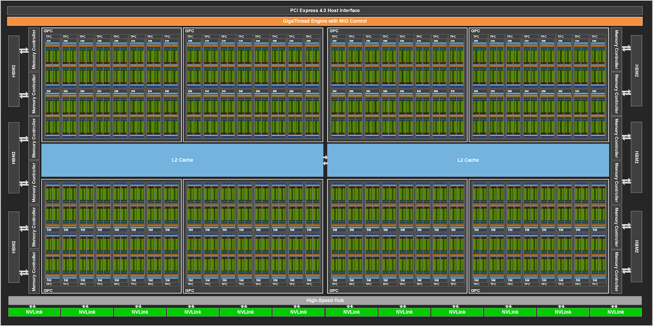
Accelerated Computing CompE596 OpenMP
OpenMP, CUDA, OpenCL, and OpenCPI
Department of Electrical and Computer Engineering
Fall 2022
C. Paolini ∙ http://paolini.sdsu.edu
Notes:
OpenCPI is a framework for developing and deploying data processing applications for heterogeneous systems consisting of General Purpose Processors (GPPs), Field Programmable Gate Arrays (FPGAs), and other processors.

Slide 2

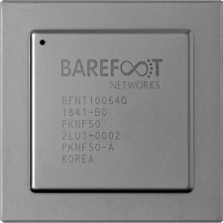
OpenMP What is it good for?
OpenMP is a framework that makes it easier to program parallel and heterogeneous systems
What is a heterogeneous system?
A heterogeneous computing system is a system that contains different types of computational units, such as multicore (general-purpose) CPUs, GPUs, DSPs, FPGAs, and (programmable) ASICs (application-specific integrated circuit is an integrated circuit).
General-purpose CPUs are tasked with operating system process execution.
Example of a programmable ASIC: the Intel® Tofino™ P4-programmable Ethernet switch ASIC
Notes:
https://www.intel.com/content/www/us/en/products/network-io/programmable-ethernet-switch/tofino-series.html

Slide 3
OpenMP What is it exactly?
OpenMP is an extension to the C, C++, and Fortran programming language
OpenMP is not a programming language itself
One adds annotations to existing code to implement parallelism and/or hardware offloading (executing code on a hardware accelerator such as a GPU)
OpenMP allows a developer to define regions of code that can be executed in parallel (simultaneously) by hardware threads operating on CPU cores
OpenMP also allows a developer to decompose an overall computational algorithm and distribute portions of an algorithm to threads that handle workloads

Slide 4
OpenMP A Brief History
OpenMP standard 24 years old
First version (1.0) for Fortran released October 1997
First version for C/C++ released October 1998
Continues to evolve, current version is 5.2 (November 2021)
OpenMP Architecture Review Board (ARB) decides what goes into the standard

Slide 5
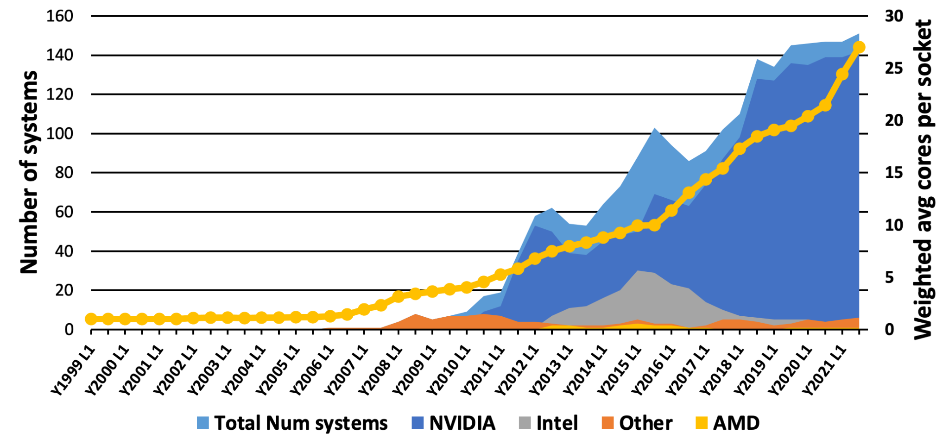
OpenMP Top500 systems
The OpenMP Standards evolution
OpenMP 2.0
OpenMP 2.5
OpenMP 3.1
OpenMP 4.5
OpenMP 5.1
OpenMP 1.0
OpenMP 2.0
OpenMP 3.0
OpenMP 4.0
OpenMP 5.0
OpenMP 5.2
Parallel regions
Tasking
Device offloading / SIMD

Slide 6

OpenMP State-of-theArt CPU
AMD EPYC 7A53 ‘Trento’ 64 Core CPU, based on an optimized version of the Milan chip
3rd Gen Optimized EPYC CPU architecture
64 cores and 128 threads (2 hardware threads/core) but optimizations to clocks and power efficiency.
Each CPU has access to 512 GB of DDR4 (Double Data Rate 4 Synchronous Dynamic Random-Access) memory.
Oak Ridge National Laboratory Crusher HPC system
Crusher is a test platform for ORNL's upcoming Frontier supercomputer (first to system break the exaflop ceiling at 1.102 exaflop/s - 10¹⁸ IEEE 754 double precision (64-bit) operations (multiplications and/or additions) per second. As of June 2022, it is the world's fastest supercomputer.)

Slide 7



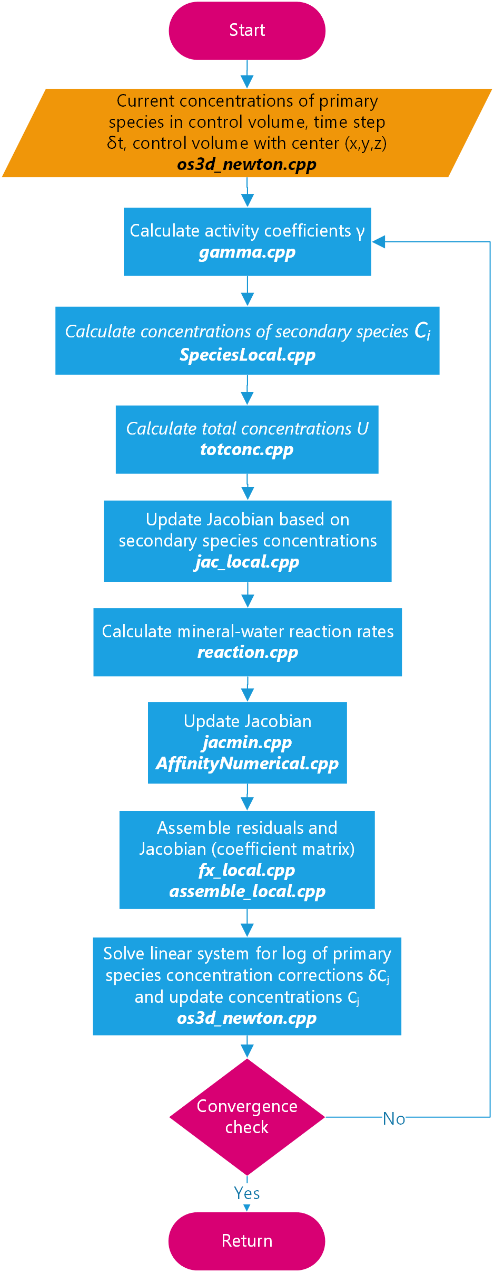
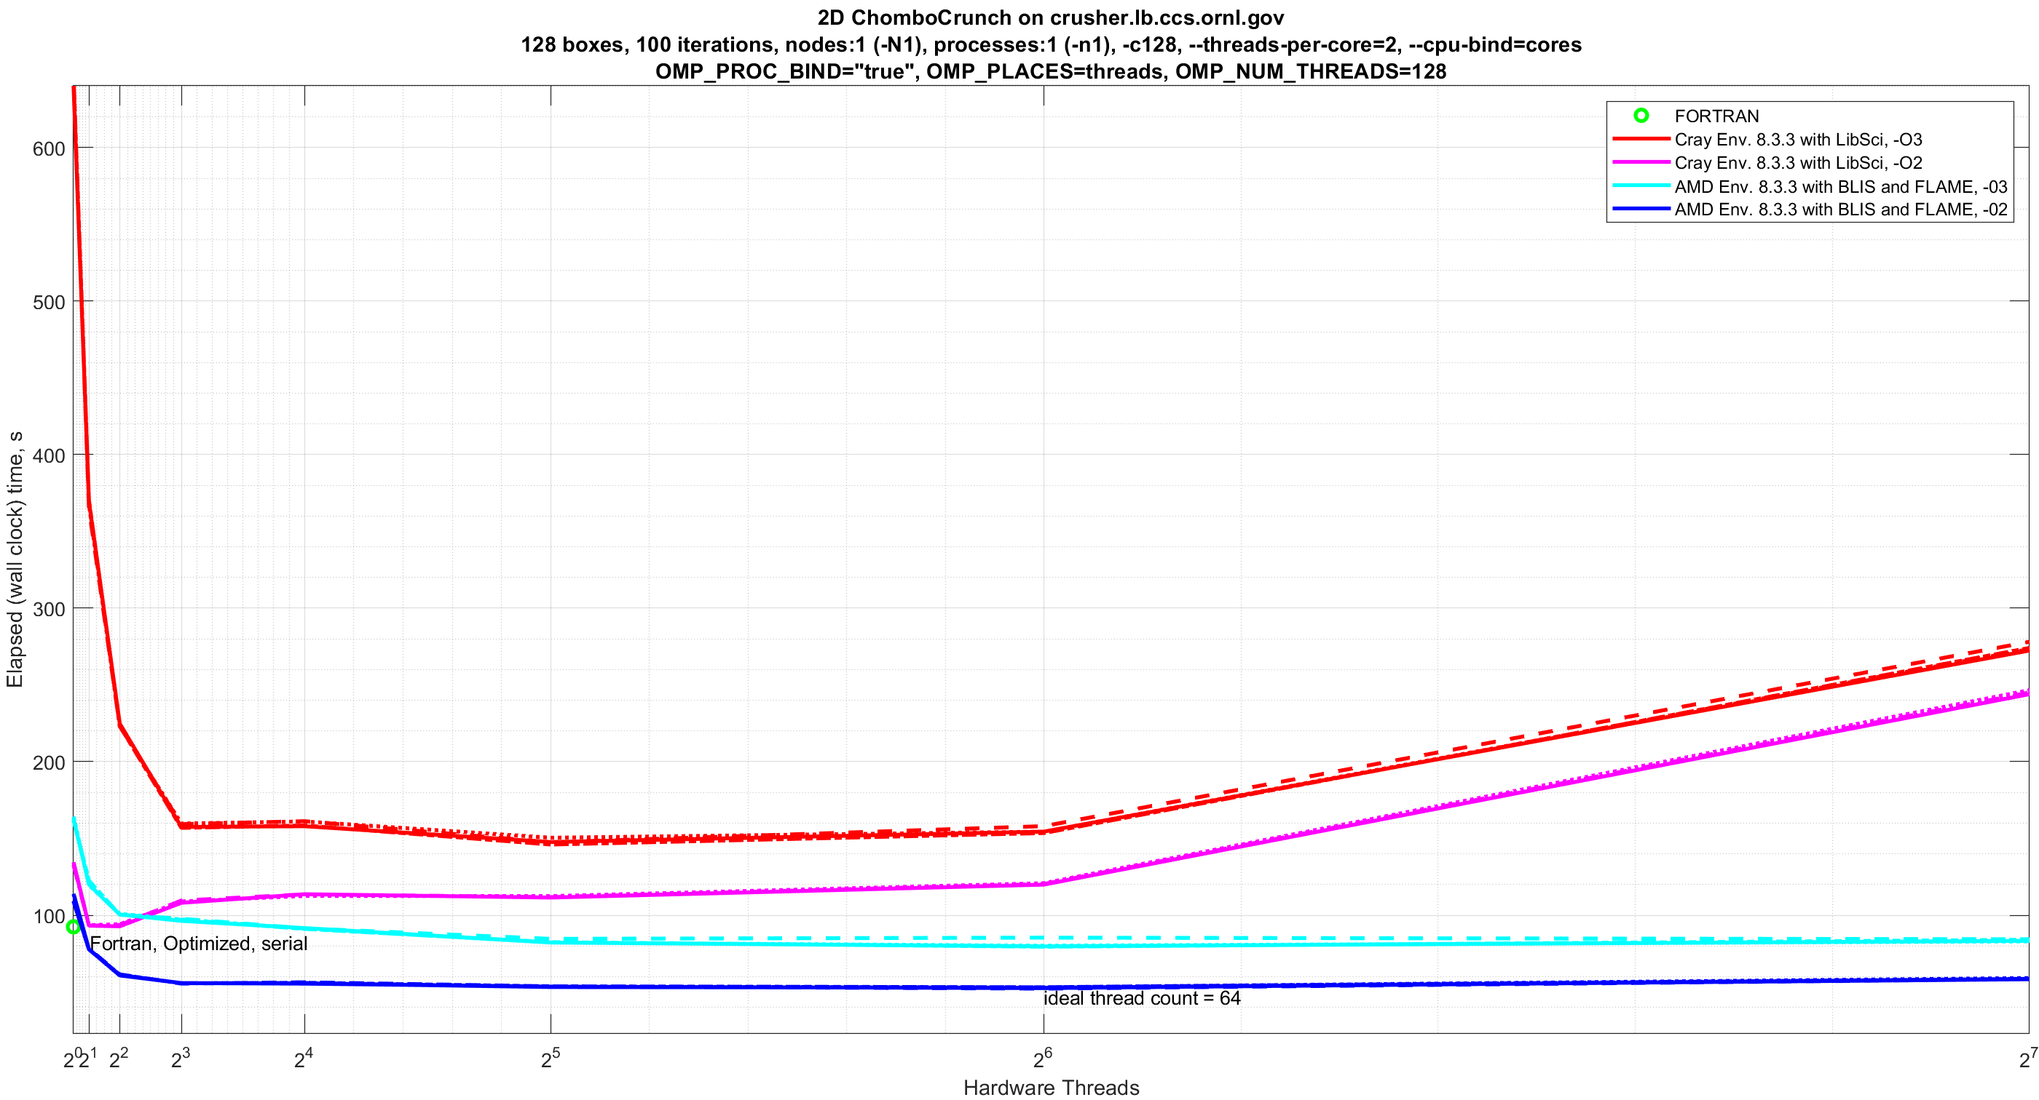
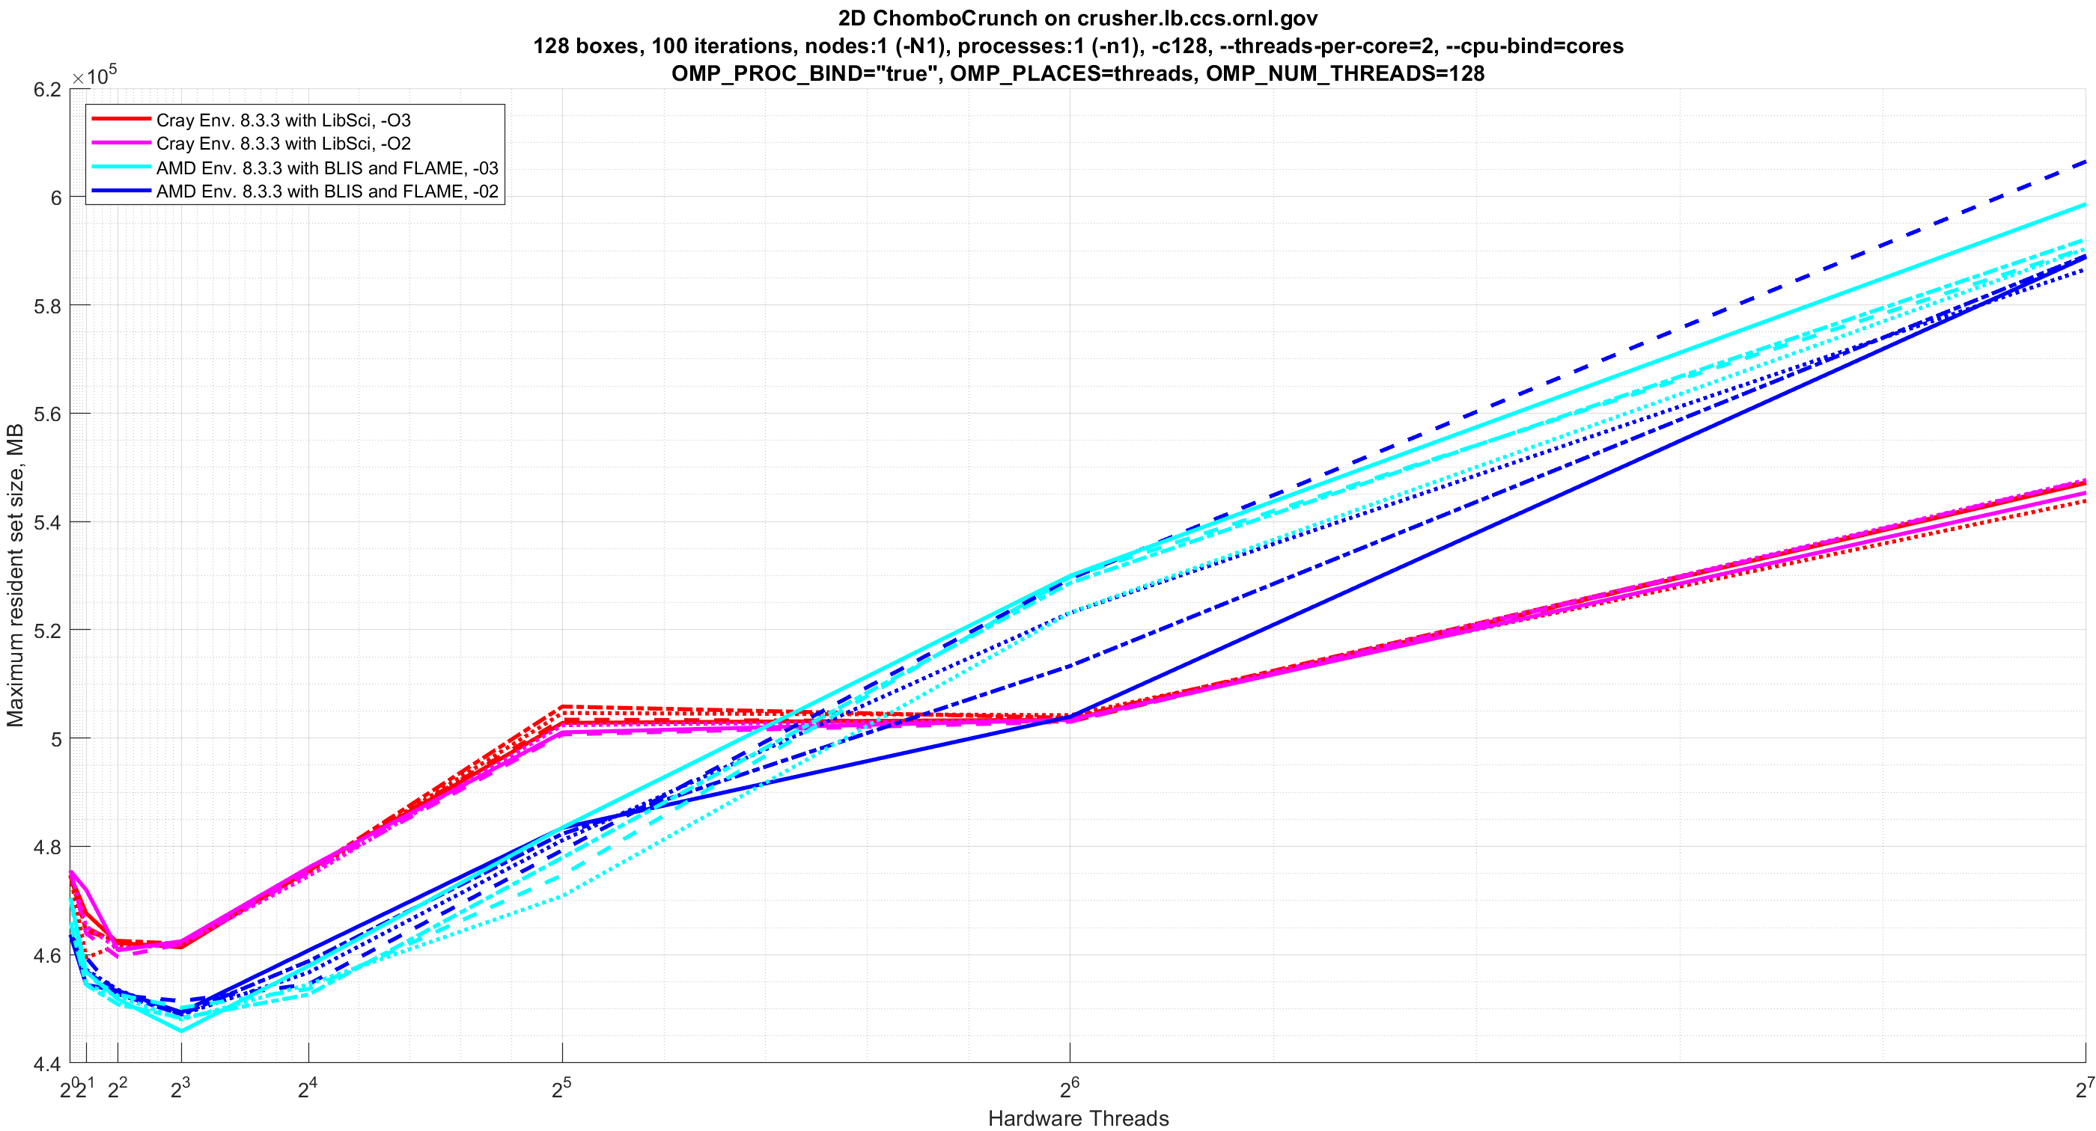
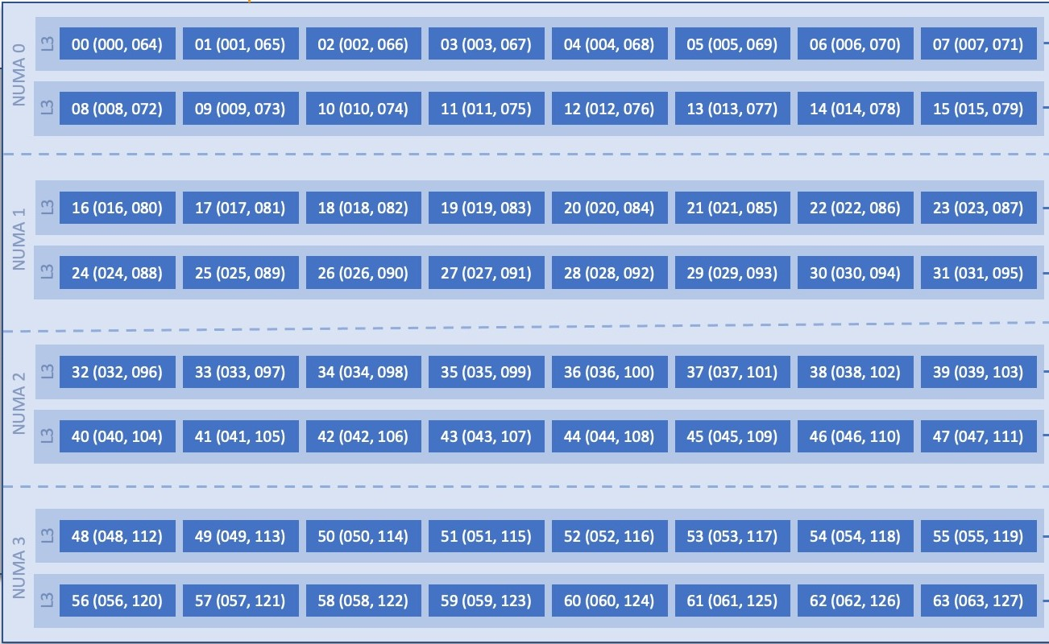
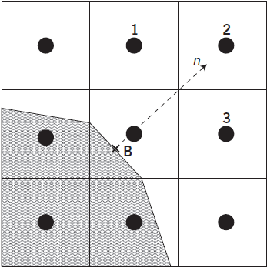
IoTLab
Accelerating LBNL Chombo-Crunch using CUDA and OpenMP Dynamic Parallelism
Jared Brzenski², Christopher Paolini^{1,2}, and David Trebotich³
¹Electrical and Computer Engineering, ²Computational Science Research Center, and ³Applied Numerical Algorithms Group
^{1,2}San Diego State University and ³Lawrence Berkeley National Laboratory
https://iotlab.sdsu.edu/
Divide domain into 128 boxes and assign an EPYC 7A53 hardware thread to each box.
EPYC 7A53: 64 cores, 2 hardware threads/core (simultaneous multithreading or SMT)
Each thread iterates over each volume within a box
SRP-HPC: End of Summer Lightning Talk ⋅ Tuesday, August 9 ⋅ 11:00am – 12:30pm
Notes:
Example speedup: OpenMP on AMD EPYC 7A53

Slide 8
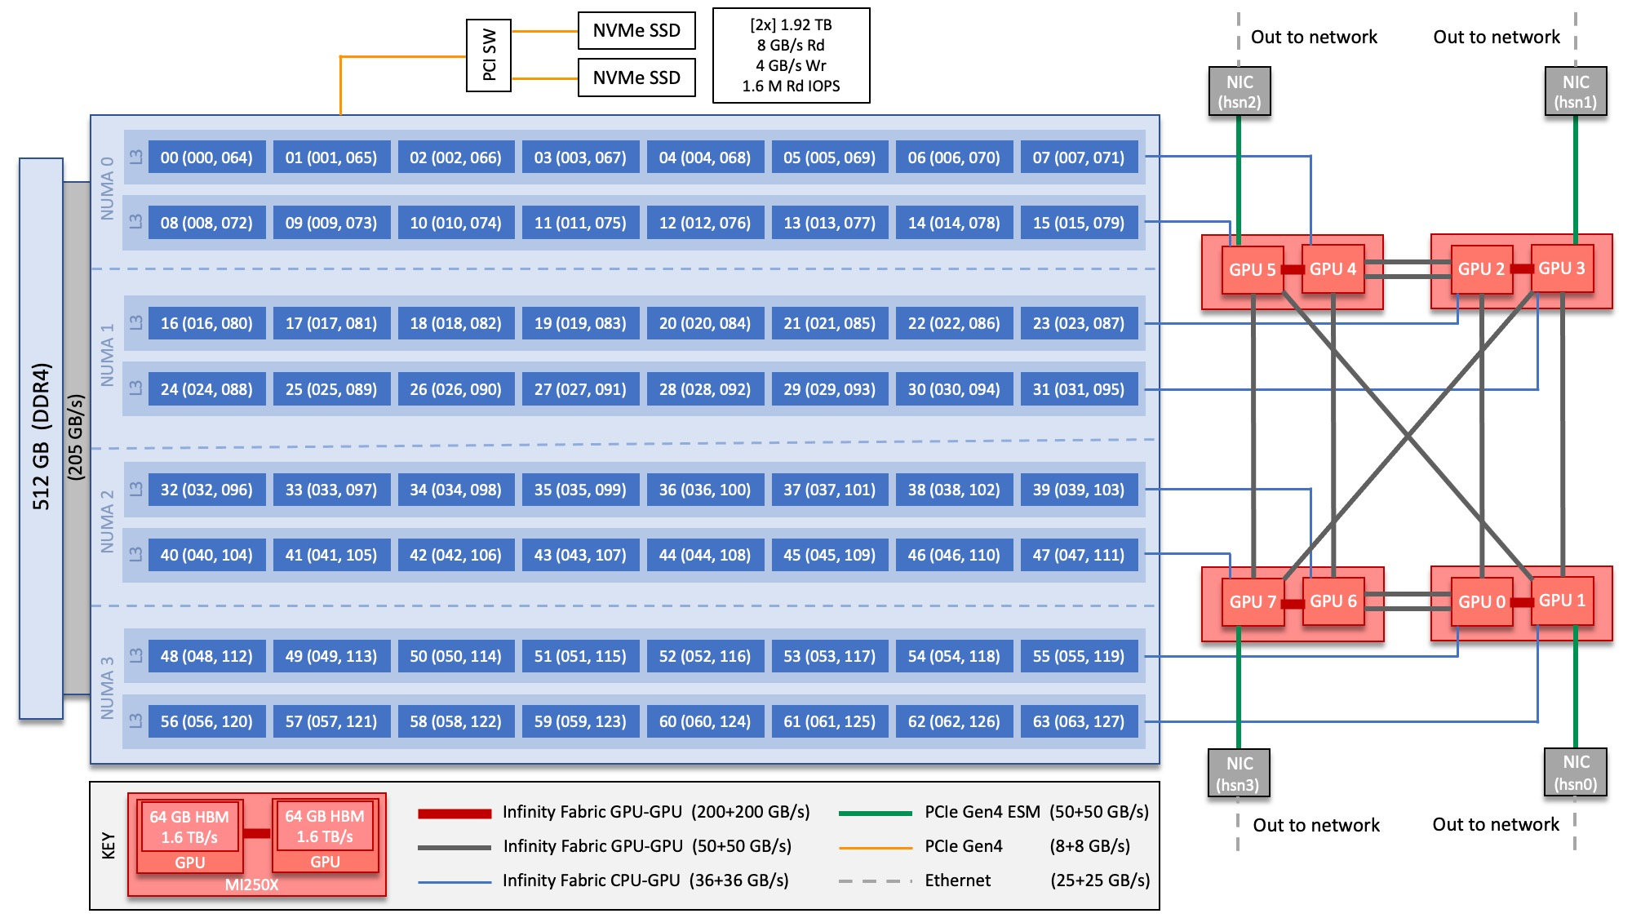
64-core AMD EPYC 7A53
“Optimized 3rd Gen EPYC” CPU
2 hardware threads per physical core

Slide 9
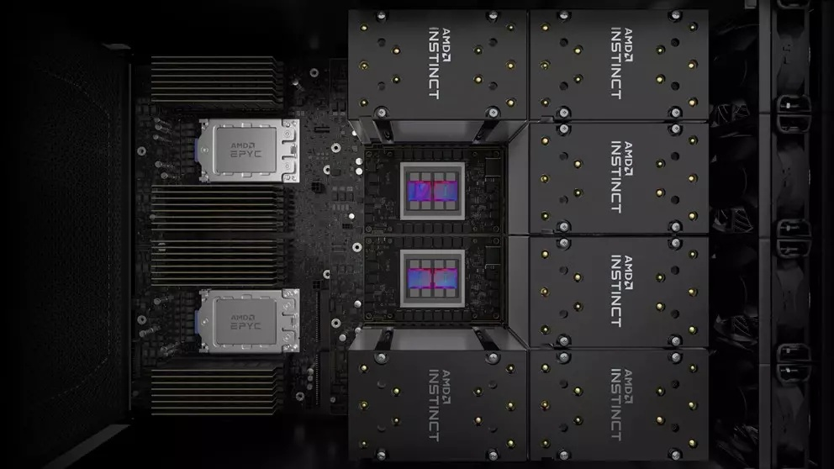
OpenMP AMD EPYC 7A53 Trento
Two 7A53s shown with six AMD Instinct MI250X GPUs

Slide 10
OpenMP History of functionality
OpenMP 2.0
OpenMP 2.5
OpenMP 2.0
OpenMP 2.5
OpenMP 3.1
OpenMP 3.1
OpenMP 4.5
OpenMP 5.1
OpenMP 4.5
OpenMP 5.1
OpenMP 1.0
OpenMP 2.0
OpenMP 4.0
OpenMP 5.0
OpenMP 5.2
OpenMP 1.0
OpenMP 2.0
OpenMP 3.0
OpenMP 4.0
OpenMP 5.0
OpenMP 5.2
OpenMP 3.0
1998
2022
Parallel
DO / for
Single
Sections
Workshare
Master
Critical
Barrier
Atomic
Flush
Ordered
Threadprivate
Clauses
Private
Shared
Firstprivate
Lastprivate
Reduction
Copyin
Copyprivate
Num_threads
If
Nowait
Default
Schedule
Static
Dynamic
Guided
Runtime

Slide 11
OpenMP History of functionality
OpenMP 2.0
OpenMP 2.5
OpenMP 2.0
OpenMP 2.5
OpenMP 3.1
OpenMP 3.1
OpenMP 4.5
OpenMP 5.1
OpenMP 4.5
OpenMP 5.1
OpenMP 1.0
OpenMP 2.0
OpenMP 4.0
OpenMP 5.0
OpenMP 5.2
OpenMP 1.0
OpenMP 2.0
OpenMP 3.0
OpenMP 4.0
OpenMP 5.0
OpenMP 5.2
OpenMP 3.0
1998
2022
Task
Taskyield
Task scheduling
Clauses
Depend
Schedule
Auto
Tasking clauses
Final
Untied
Mergable

Slide 12
OpenMP History of functionality
OpenMP 2.0
OpenMP 2.5
OpenMP 2.0
OpenMP 2.5
OpenMP 3.1
OpenMP 3.1
OpenMP 4.5
OpenMP 5.1
OpenMP 4.5
OpenMP 5.1
OpenMP 1.0
OpenMP 2.0
OpenMP 4.0
OpenMP 5.0
OpenMP 5.2
OpenMP 1.0
OpenMP 2.0
OpenMP 3.0
OpenMP 4.0
OpenMP 5.0
OpenMP 5.2
OpenMP 3.0
1998
2022
OpenMP 4.0
target [data]
declare target
target update
simd
declare simd
loop simd
Teams
distribute
OpenMP 4.5
taskloop
taskloop simd
target enter data
target exit data
target simd
OpenMP 5.0
allocate
declare mapper
declare variant
Memory spaces
parallel loop
teams loop
requires
scan
OpenMP 5.1
Variant dispatch
declare mapper
Memory spaces
parallel loop
teams loop
Interop
masked
scope
tile/unroll
OpenMP 5.2
ompx
Reorganization
More being added

Slide 13
OpenMP Threads and Multithreading
Hardware Threads vs Software Threads
A thread can be thought of as a worker that independently executes the instructions (sequentially, conditionally, and iteratively) of a process forked and executed by an operating system
A thread interacts with shared (among threads of a process) memory and private memory
Multithreading refers to the use of multiple threads that independently and simultaneously execute the instructions of a process
Inclusion of multiple threads in a process requires developer to coordinate threads such that shared memory is not corrupted via race conditions, and algorithms are not subjected to out-of-order computation
Developer needs to implement thread communication, task assignments, and resource (hardware accelerator, e.g., FPGA, GPU) sharing

Slide 14
OpenMP Thread Management
Instantiating (creating) threads
Assigning computational work to threads
Implementing communication among threads

Slide 15
OpenMP The Fork-Join Model
Execution starts with a single thread (thread 0)
#pragma omp parallel spawns multiple threads
⁞
⁞
At the end of the parallel region, execution returns to a single thread (thread 0)
You can consider a “non-threaded” process as a process with only one worker: thread 0

Slide 16
OpenMP The Parallel Directive
Thread creation:
Spawn N threads
Work assignment:
All threads execute the same code
Communication:
Via shared memory
All threads wait at the end of the region (e.g., there is an execution barrier)
⁞
N threads.

Slide 17
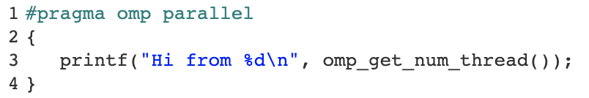
OpenMP Parallel Example
Thread creation:
Spawn N threads
Work assignment:
All threads execute the same code
Communication:
Via shared memory
All threads wait at the end of the region (e.g., there is an execution barrier)
⁞
N threads.
omp_get_thread_num());

Slide 18
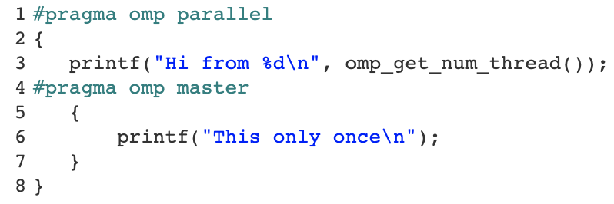
OpenMP Master Directive
Thread creation:
Spawn N threads
Work assignment:
Parallel: Region of code for all threads
Master: Region of code for a single thread
Communication:
Via shared memory
All threads wait at the end of the region (e.g., there is an execution barrier)
⁞
N threads.
omp_get_thread_num());

Slide 19
OpenMP Example on dgx.sdsu.edu
dgx.sdsu.edu has two AMD EPYC 7742 ”Rome” 64-Core Processors
Based on the Zen 2 microarchitecture
paolini@dgx:~/compe596$ lscpu | more
Architecture: x86_64
CPU op-mode(s): 32-bit, 64-bit
Byte Order: Little Endian
Address sizes: 43 bits physical, 48 bits virtual
CPU(s): 256
On-line CPU(s) list: 0-255
Thread(s) per core: 2
Core(s) per socket: 64
Socket(s): 2
NUMA node(s): 8
Vendor ID: AuthenticAMD
CPU family: 23
Model: 49
Model name: AMD EPYC 7742 64-Core Processor
Notes:
https://www.amd.com/en/products/cpu/amd-epyc-7742
https://en.wikichip.org/wiki/amd/cores/rome

Slide 20
OpenMP Example on dgx.sdsu.edu
#include <omp.h>
#include <stdio.h>
#include <stdlib.h>
#include <time.h>
#include <math.h>
int main (int argc, char *argv[])
{
#pragma omp parallel
{
printf("Hi from thread number %d\n", omp_get_thread_num());
}
return 0;
}

Slide 21
OpenMP Example on dgx.sdsu.edu
paolini@dgx:~/compe596$ gcc -fopenmp hi.c -o hi
paolini@dgx:~/compe596$ export OMP_NUM_THREADS=8
paolini@dgx:~/compe596$ ./hi
Hi from thread number 3
Hi from thread number 4
Hi from thread number 2
Hi from thread number 5
Hi from thread number 6
Hi from thread number 7
Hi from thread number 1
Hi from thread number 0

Slide 22
OpenMP Example on dgx.sdsu.edu
#include <omp.h>
#include <stdio.h>
#include <stdlib.h>
#include <time.h>
#include <math.h>
int main (int argc, char *argv[])
{
#pragma omp parallel
{
printf("Hi from thread number %d\n", omp_get_thread_num());
#pragma omp master
{
printf("This only once %d\n", omp_get_thread_num());
}
}
return 0;
}

Slide 23
OpenMP Example on dgx.sdsu.edu
paolini@dgx:~/compe596$ gcc -fopenmp hi2.c -o hi2
paolini@dgx:~/compe596$ export OMP_NUM_THREADS=16
paolini@dgx:~/compe596$ ./hi2
Hi from thread number 2
Hi from thread number 14
Hi from thread number 5
Hi from thread number 6
Hi from thread number 12
Hi from thread number 15
Hi from thread number 9
Hi from thread number 7
Hi from thread number 11
Hi from thread number 10
Hi from thread number 4
Hi from thread number 1
Hi from thread number 13
Hi from thread number 3
Hi from thread number 8
Hi from thread number 0
This only once 0

Slide 24
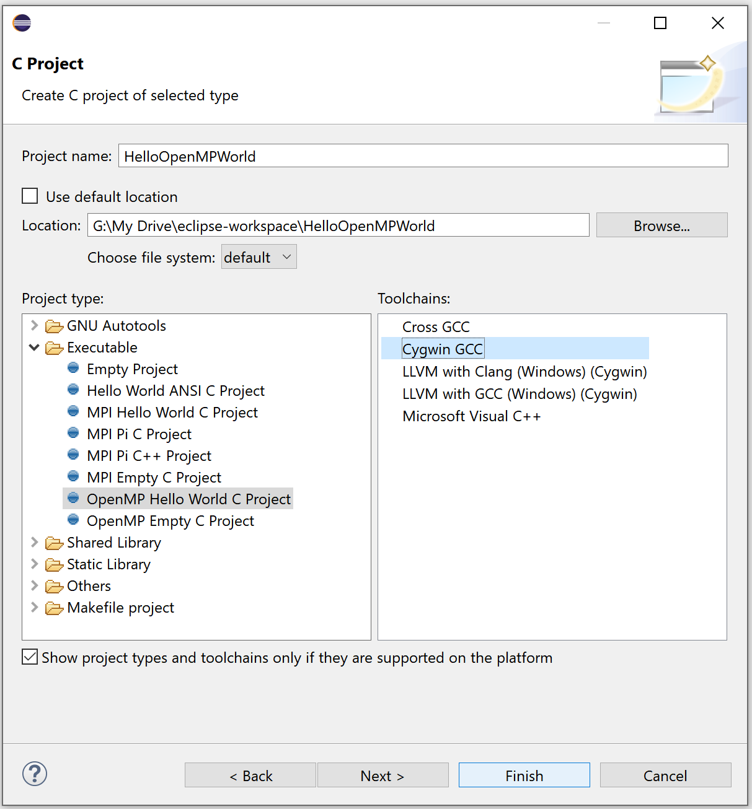
OpenMP Cygwin Toolchain

Slide 25


Eclipse IDE for Scientific Computing
https://www.eclipse.org/downloads/

Slide 26
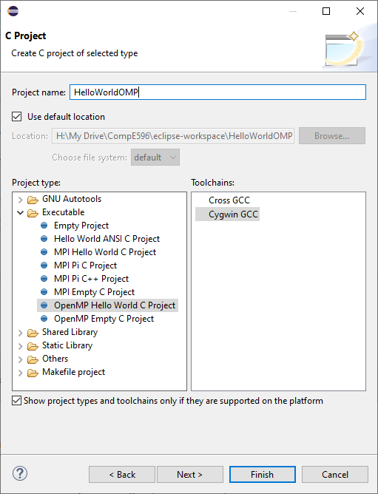
Eclipse IDE
Test the OpenMP “hi” program on your laptop
Use the Cygwin GCC toolchain

Slide 27
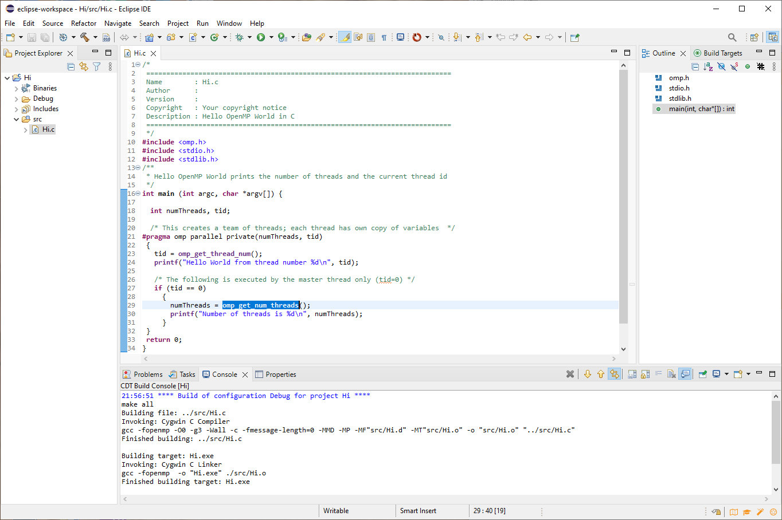
OpenMP Cygwin Toolchain

Slide 28
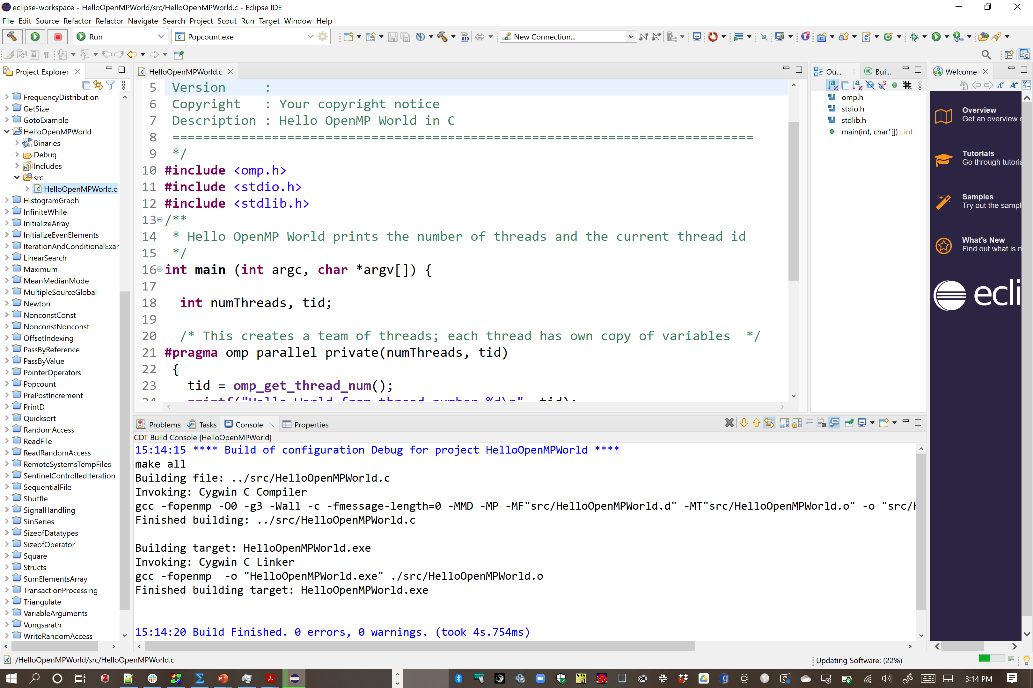
OpenMP Cygwin Toolchain
-fopenmp
argument required

Slide 29
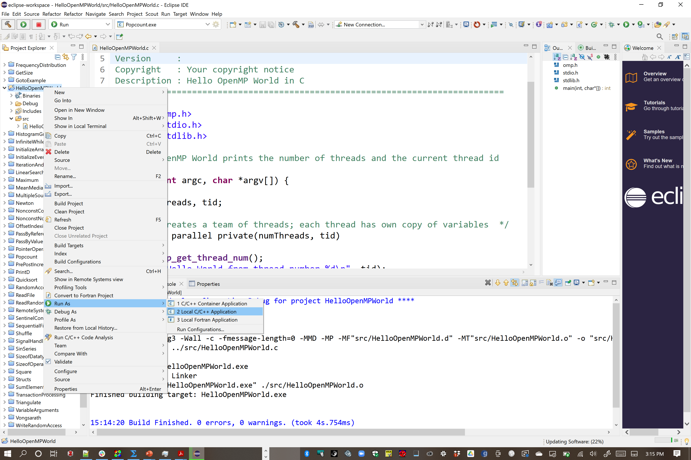
OpenMP Cygwin Toolchain

Slide 30
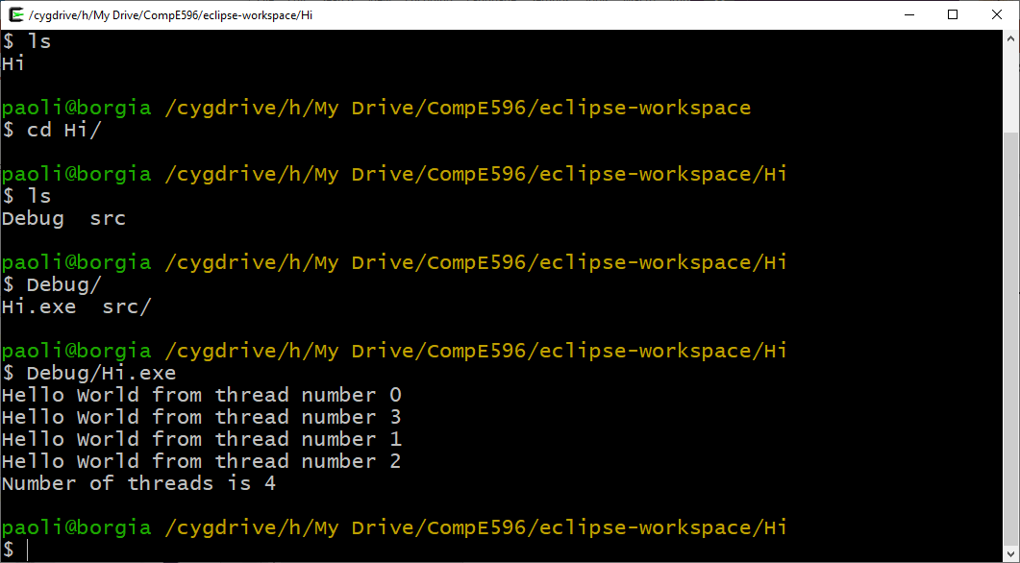
Cygwin64 Terminal Invocation

Slide 31
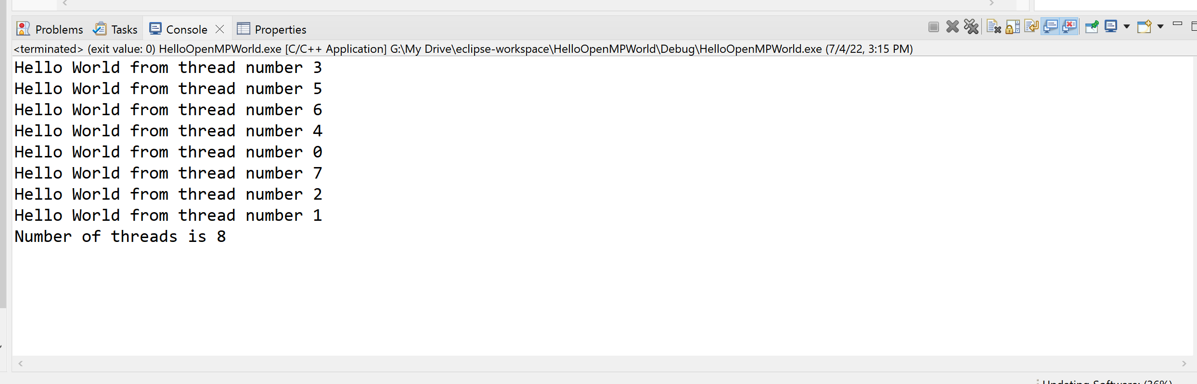

OpenMP Cygwin Toolchain
My Microsoft Surface 2: Intel(R) Core(TM) i7-8650U CPU @ 1.90GHz 2.11 GHz “Kaby Lake-R”
CPU Specifications
Total Cores 4 (number of independent central processing units in a single computing die)
Total Threads 8 (Intel Hyper-Threading)
Max Turbo Frequency 4.20 GHz
Intel® Turbo Boost Technology 2.0 Frequency‡ 4.20 GHz
Processor Base Frequency 1.90 GHz
Cache 8 MB Intel® Smart Cache
Notes:
https://www.intel.com/content/www/us/en/products/sku/124968/intel-core-i78650u-processor-8m-cache-up-to-4-20-ghz/specifications.html
https://www.techpowerup.com/cpu-specs/core-i7-8650u.c1975

Slide 32
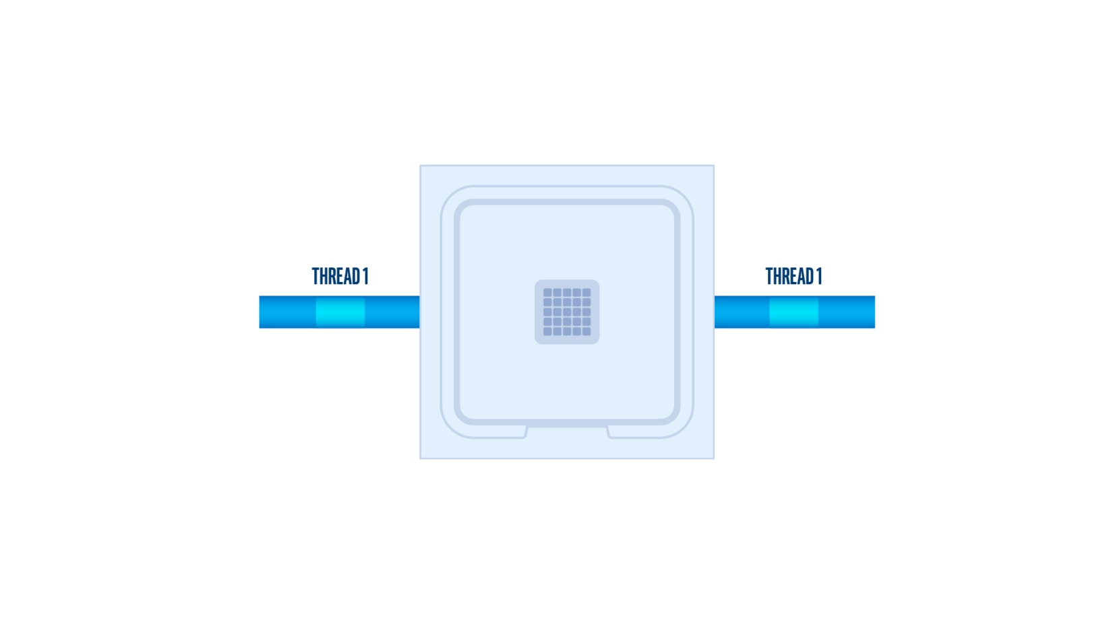
OpenMP Intel® Hyper-Threading
Intel® Hyper-Threading Technology (Intel® HT Technology)
CPU exposes two execution contexts per physical core.
One physical core now works like two “logical cores” that can handle different software threads.
Logical cores can work through tasks more efficiently than a traditional single-threaded core.
Idle time: when the core would formerly be waiting for other tasks to complete, Intel® Hyper-Threading Technology improves CPU throughput by up to 30% in server applications
Enabled by default, but it can be switched on and off from the BIOS environment by setting “Hyper-Threading Technology” to “Enable” or “Disable”.
Notes:
https://www.intel.com/content/www/us/en/gaming/resources/hyper-threading.html

Slide 33
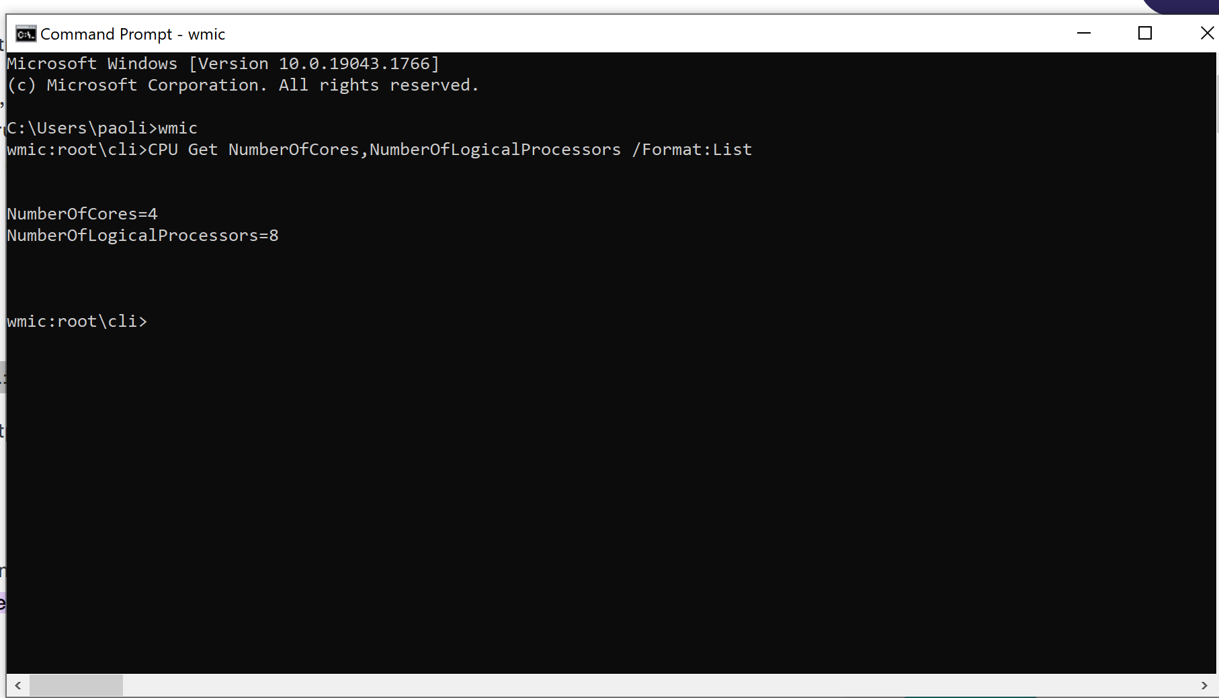
OpenMP Intel® Hyper-Threading
Number of logical processors = 2x number of physical cores => HT is enabled.
Determine if your Windows system is using hyperthreading.
Notes:
https://www.intel.com/content/www/us/en/gaming/resources/hyper-threading.html

Slide 34
OpenMP Intel® Hyper-Threading
paolini@notos:/mnt/beegfs/paolini-notos$ sudo dmidecode -t processor | grep Count
Core Count: 8
Thread Count: 16
Core Count: 8
Thread Count: 16
Hyperthreading: use one core to process two threads.
Exposes two virtual CPUs to an operating system from one physical CPU
Whenever there is free time on a CPU core, hyperthreading will push another, separate thread to be processed.
Generally, increases performance by about 20% vs no hyperthreading.
Number of logical processors = 2x number of physical cores => HT is enabled.
Determine if your Windows system is using hyperthreading.
Notes:
https://www.intel.com/content/www/us/en/gaming/resources/hyper-threading.html

Slide 35
OpenMP AMD EPYC® SMT
paolini@dgx:~$ lscpu
Architecture: x86_64
CPU op-mode(s): 32-bit, 64-bit
Byte Order: Little Endian
Address sizes: 43 bits physical, 48 bits virtual
CPU(s): 256
On-line CPU(s) list: 0-255
Thread(s) per core: 2
Core(s) per socket: 64
Socket(s): 2
NUMA node(s): 8
Vendor ID: AuthenticAMD
CPU family: 23
Model: 49
Model name: AMD EPYC 7742 64-Core Processor
Stepping: 0
Frequency boost: enabled
CPU MHz: 2349.978
CPU max MHz: 2250.0000
CPU min MHz: 1500.0000
BogoMIPS: 4491.37
Virtualization: AMD-V
L1d cache: 4 MiB
L1i cache: 4 MiB
L2 cache: 64 MiB
L3 cache: 512 MiB
2 hardware threads per 64 physical cores => 128 hardware threads available
AMD’s implementation is called simultaneous multithreading (SMT).
Notes:
https://www.intel.com/content/www/us/en/gaming/resources/hyper-threading.html
https://en.wikipedia.org/wiki/Simultaneous_multithreading

Slide 36
OpenMP Memory
Shared, private, distributed

Slide 37
OpenMP Syntax
Points

Slide 38
OpenMP title
Points

Slide 39
OpenMP DGEMM
export OMP_NUM_THREADS=128
paolini@dgx:~/compe596/mt-dgemm$ numactl --physcpubind=64-255 --membind=0 ./mt-dgemm 4096
Matrix size input by command line: 4096
Repeat multiply defaulted to 30
Alpha = 1.000000
Beta = 1.000000
Allocating Matrices...
Allocation complete, populating with values...
Performing multiplication...
--membind=nodes, -m nodes
Only allocate memory from nodes. Allocation will fail when there is not enough memory available on these nodes.
nodes may be specified as noted above.
--physcpubind=cpus, -C cpus
Only execute process on cpus. This accepts cpu numbers as shown in the processor fields of /proc/cpuinfo, or
relative cpus as in relative to the current cpuset. You may specify "all", which means all cpus in the current
cpuset. Physical cpus may be specified as N,N,N or N-N or N,N-N or N-N,N-N and so forth. Relative cpus may
be specifed as +N,N,N or +N-N or +N,N-N and so forth. The + indicates that the cpu numbers are relative to the
process' set of allowed cpus in its current cpuset. A !N-N notation indicates the inverse of N-N, in other
words all cpus except N-N. If used with + notation, specify !+N-N.
Notes:
http://developer.amd.com/wp-content/resources/56420.pdf page 30
https://portal.nersc.gov/project/m888/apex/mt-dgemm_160114.tgz

Slide 40
OpenMP DGEMM
export OMP_NUM_THREADS=128
paolini@dgx:~/compe596/mt-dgemm$ numactl --physcpubind=64-255 --membind=0 ./mt-dgemm 4096
Matrix size input by command line: 4096
Repeat multiply defaulted to 30
Alpha = 1.000000
Beta = 1.000000
Allocating Matrices...
Allocation complete, populating with values...
Performing multiplication...
Calculating matrix check...
===============================================================
Final Sum is: 4096.033333
-> Solution check PASSED successfully.
Memory for Matrices: 384.000000 MB
Multiply time: 2381.797337 seconds
FLOPs computed: 4124175237120.000000
GFLOP/s rate: 1.731539 GF/s
===============================================================
Non-optimized matrix multiplication
Notes:
http://developer.amd.com/wp-content/resources/56420.pdf page 30
https://portal.nersc.gov/project/m888/apex/mt-dgemm_160114.tgz

Slide 41
OpenMP DGEMM
export OMP_NUM_THREADS=128
BLIS optimized matrix multiplication
Notes:
http://developer.amd.com/wp-content/resources/56420.pdf page 30
https://portal.nersc.gov/project/m888/apex/mt-dgemm_160114.tgz
https://github.com/flame/blis/blob/master/docs/Multithreading.md#choosing-openmp-vs-pthreads

Slide 42
OpenMP HPL
Points

Slide 43
OpenMP Functions
Function outlining, implementation and runtime

Slide 44
OpenMP critical construct
#pragma omp critical[(name)]
Defines a critical section of code
Prevents multiple threads from updating same shared code simultaneously

Slide 45
OpenMP omp_init_lock
Initialize a simple lock
After initialization, the lock is in an unlocked state.
The calling thread is blocked until the lock is available.
void omp_init_lock(omp_lock_t *lock);
Example:
omp_lock_t lock;
omp_init_lock(&lock);

Slide 46
OpenMP omp_set_lock
Wait for and set simple lock
Before setting a simple lock, the lock variable must be initialized by omp_init_lock.
The calling thread is blocked until the lock is available.
If the lock is already held by the current thread, a deadlock occurs.
void omp_set_lock(omp_lock_t *lock);

Slide 47
OpenMP
OpenMP API
The OpenMP API supports multi-platform shared-memory parallel programming in C/C++ and Fortran. The OpenMP API defines a portable, scalable model with a simple and flexible interface for developing parallel applications on platforms from the desktop to the supercomputer.
API is implemented as a collection of #pragma (“pragmatic") compiler directives
Configures how a preprocessor or compiler processes input source code.

Slide 48
OpenMP Syntax
#pragma omp construct
{
// block encapsulated by scoping operators {}
.
.
.
}

Slide 49
Numerical Integration (“Quadrature”)
Suppose you needed to numerically integrate a function f(x) over a defined range [a,b], i.e.
This is needed when there is no apparent analytical solution.
The two simplest methods are the rectangle method and the trapezoid method. In the rectangle method, one discretizes the range [a,b] and computes the area under the function by summing the individual areas of rectangles that approximate the function f(x)

Slide 50
Rectangle Method
Summation over all rectangles
Area of each rectangle is A = wh
w = Δx
h =
First, divide the range [a,b] into N intervals on the x-axis, delineated by points, x₁, x₂, x₃, …, x_{N+1}
Evaluate the function f(x) at the midpoint of x_{i} and x_{i+1} to compute the height h of each rectangle in the interval x_{i} and x_{i+1}

Slide 51
Trapezoid Method
Summation over all trapezoids
Area of a trapezoid is A =
where a, b (not to be confused with the domain interval values), and h are defined as

Slide 52
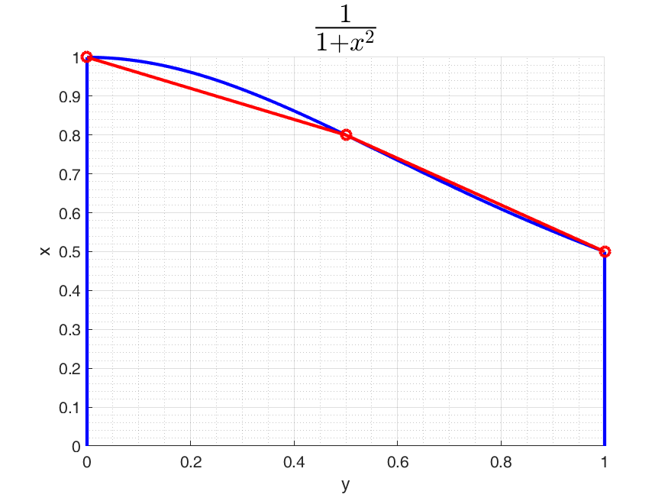
Example: Multithreaded Composite ⅓ Simpson’s Method
Define k+1 data points, indexed 0,…,j,…,k, with k = 2 to form a quadratic Lagrange interpolation polynomial:
(x₀,y₀) = (0.0,1.0)
(x₁,y₁) = (0.5,0.8)
(x₂,y₂) = (1.0,0.5)
Define k+1 Lagrange basis polynomials, l_{j}(x)
Example:
l0 = ((x - x(1))./(x(j) - x(1))) .* ((x - x(2))./(x(j) - x(2)));
l1 = ((x - x(0))./(x(j) - x(0))) .* ((x - x(2))./(x(j) - x(2)));
l2 = ((x - x(0))./(x(j) - x(0))) .* ((x - x(1))./(x(j) - x(1)));
Define Lagrange 2nd order interpolation polynomial as a linear combination of basis polynomials, then integrate over interval [a,b]
Consider
l_{j}(x) is 1 at point x_{j} and 0 at all other points
Notes:
(Reservation # 20220103-00001) from 10-11am by Robyn.
https://en.wikipedia.org/wiki/Lagrange_polynomial
https://en.wikipedia.org/wiki/Simpson%27s_rule

Slide 53
Derivation of Weights w₀ and w₂
By symmetry w₀ = w₂

Slide 54
Derivation of Weight w₁
>> syms x0 x2 t x x1
>> x1 = (x0+x2)/2;
>> x = t*(x2-x0)/2 + (x2+x0)/2;
>> simplify(((x-x0)/(x1-x0))*((x-x2)/(x1-x2))*((x2-x0)/2))
ans =
((t^2 - 1)*(x0 - x2))/2
>> int(((t^2 - 1)*(x0 - x2))/2,t,-1,1)
ans =
(2*x2)/3 - (2*x0)/3
w₁

Slide 55
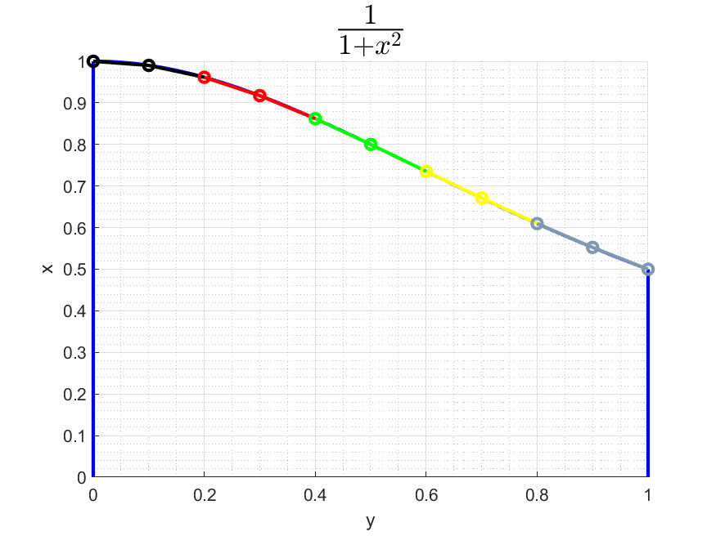
Integral of the Lagrange 2nd order interpolation polynomial over interval h
“Composite ⅓ Simpson’s Method”
Divide total interval [a,b] into N subintervals of length h, with each subinterval discretized by three points [x₀,x₁,x₂]. Assign a separate thread to integrate each subinterval in parallel.

Slide 56
Example: Multithreaded Composite ⅓ Simpson’s Method
paolini@dgx:~/compe160 g++ -fopenmp Simpson.cpp -o simpson
paolini@dgx:~/compe160$ ./simpson 1
requesting 1 threads
Nthrds: 1
Elapsed time = 434246[us]
approximation: 0.785398, error: 6.657676e-09
paolini@dgx:~/compe160$ ./simpson 32
requesting 32 threads
Nthrds: 32
Elapsed time = 277361[us]
approximation: 0.785399, error: 4.809711e-07
paolini@dgx:~/compe160$
Notes:
https://github.com/tgmattso/OpenMP_intro_tutorial

Slide 57
Example: Multithreaded Composite ⅓ Simpson’s Method
Code: Simpson.cpp
Include OpenMP function prototypes
#include <omp.h>
Disable system from dynamically varying the number of threads per parallel construct and specify a constant number of threads
sscanf(argv[1],"%d",&Nthrds);
std::cout << "requesting " << Nthrds << " threads" << std::endl;
omp_set_dynamic(0);
omp_set_num_threads(Nthrds);

Slide 58
Example: Multithreaded Composite ⅓ Simpson’s Method
OpenMP compiler directive
#pragma omp parallel
{
unsigned int istart, iend;
int id, N = (int)n / 2;
id = omp_get_thread_num();
istart = id * N / Nthrds;
iend = (id + 1) * N / Nthrds;
if (id == Nthrds - 1) iend = N;
for (unsigned int j = istart+1; j <= iend; ++j)
{
// xj = a + j * h;
s[id] += f(a + (2 * j - 2) * h) + 4 * f(a + (2 * j - 1) * h) + f(a + (2 * j) * h);
}
s[id] *= h / 3;
}
OpenMP parallel block construct
Current thread ID in range [0,Nthrds]
Assign a group of consecutive intervals to one unique thread
Each thread simultaneously accumulates sum of approximate interval integrals

Slide 59
Example: Multithreaded Composite ⅓ Simpson’s Method
OpenMP Synchronization compiler directive
#pragma omp critical
std::cout << "id: " << id << ", istart: " << istart << ", iend: " << iend << std::endl;}
Show mapping between intervals and threads. Critical forces each thread to execute the following statement (or block) one thread at a time (threads wait their turn). Prevents output mangling.

Slide 60
Example: Multithreaded Composite ⅓ Simpson’s Method
Lab exercise: implement composite ⅓ Simpson’s Method in template code and experiment with number of intervals n and number of threads Nthrds to find best Nthrds for a given n
Code: Simpson.cpp

Slide 61
Riemann summation
Recall, by definition
We can find an approximation to the integral of f (assuming f is integrable) by just performing n (independent) function evaluations and then summing n (independent) results
This raises a performance issue: how can we perform the summation of many evaluation values (for large n) faster (i.e., better than linear time complexity O(n))?
Solution is to perform a reduction operation

Slide 62
Parallel reduction
data
data
data
data
data
data
data
data
op
op
op
op
data
data
data
data
op
op
data
data
performs N-1 operations (e.g., summation) in log(N) steps
op
data

Slide 63
Parallel reduction
Question: What kinds of operations (◦) are supported by a reduction?
Answer: associative and commutative operations
Recall associative property requires (a ◦ b) ◦ c = a ◦ (b ◦ c) for operation ◦
Recall commutative property requires a ◦ b = b ◦ a
Examples of supported operations: scalar multiplication (*), scalar addition (+), max, min
Examples of unsupported operations: matrix multiplication (AB ≠ BA for all A, B)

Slide 64
Parallel reduction
Consider the summation of an array of 32 elements
First summation uses 16 (i.e., N/2) threads to sum 16 different pairs
0 | 1 | 2 | 3 | 4 | 5 | 6 | 7 | 8 | 9
10 | 11 | 12 | 13 | 14 | 15 | 16 | 17 | 18 | 19
20 | 21 | 22 | 23 | 24 | 25 | 26 | 27 | 28 | 29
30 | 31

Slide 65
Parallel reduction
Consider the summation of an array of 32 elements
Second summation uses 8 (i.e., N/4) threads to sum 8 different pairs
0 | 1 | 2 | 3 | 4 | 5 | 6 | 7 | 8 | 9
10 | 11 | 12 | 13 | 14 | 15 | 16 | 17 | 18 | 19

Slide 66
Parallel reduction
Consider the summation of an array of 32 elements
Third summation uses 4 (i.e., N/8) threads to sum 4 different pairs
0 | 1 | 2 | 3 | 4 | 5 | 6 | 7 | 8 | 9

Slide 67
Parallel reduction
Consider the summation of an array of 32 elements
i^{th} summation uses N/2^{i} threads to sum i different pairs
0 | 1 | 2 | 3 | 4 | 5 | 6 | 7 | 8 | 9
0 | 1 | 2 | 3 | 4 | 5 | 6 | 7 | 8 | 9
log₂N = log₂32 = 5
Fourth
Fifth
Final sum per block in element with index 0

Slide 68
Reduction example: Riemann summation
Code starting point: RiemannSummationTemplate.cpp
const unsigned int n = (unsigned int)1e9; // number of intervals must be even
const double b = 1;
const double a = 0;
const double h = (b - a) / n; // interval length
double S = 0; // accumulated sum
// store each function evaluation at n points
double* A = (double*)calloc(n+1, sizeof(double));

Slide 69
Reduction example: Riemann summation
First parallel work: threads compute an equal set of function evaluations and write result to a non-overlapping segment of A
unsigned int istart, iend;
int id;
id = omp_get_thread_num();
istart = id * n / Nthrds;
iend = (id + 1) * n / Nthrds;
if (id == Nthrds - 1) iend = n;
for (unsigned int i = istart; i <= iend; ++i)
A[i] = f(a + i * h);

Slide 70
Reduction example: Riemann summation
Second parallel work: threads compute sum of function evaluations stored in A into accumulation variable S
int j; // must be signed for OpenMP
#pragma omp parallel for reduction (+:S)
for (j = 0; j <= n; ++j)
{
S += A[j];
}

Slide 71
OpenMP for-loop reduction syntax
#pragma omp parallel for reduction (reduction-identifier : list)
reduction-identifier: can be one of the following operators: +, -, *, &, |, ^, && and ||
list: one or more variables (shared memory) among threads
Reduction makes a local copy of each list variable and assigns a unique local copy to each thread
Upon the completion of each partial sum by each thread, the partial sums are reduced into a final aggregated sum

Slide 72
Reduction Example: Riemann summation
paolini@dgx:~/compe160$ lscpu|grep Core\(s\)
Core(s) per socket: 64
./riemann 1
requesting 1 threads
Nthrds: 1
approximation: 7.853982e-01, error: 7.499663e-10
exact (pi/4): 7.853982e-01
Elapsed time = 8257577[us]
Reduction Elapsed time = 3463383[us]
./riemann 2
requesting 2 threads
Nthrds: 2
approximation: 7.853982e-01, error: 7.499933e-10
exact (pi/4): 7.853982e-01
Elapsed time = 5185186[us]
Reduction Elapsed time = 2536866[us]
./riemann 4
requesting 4 threads
Nthrds: 4
approximation: 7.853982e-01, error: 7.500344e-10
exact (pi/4): 7.853982e-01
Elapsed time = 2420250[us]
Reduction Elapsed time = 906073[us]
./riemann 8
requesting 8 threads
Nthrds: 8
approximation: 7.853982e-01, error: 7.500305e-10
exact (pi/4): 7.853982e-01
Elapsed time = 3631497[us]
Reduction Elapsed time = 544299[us]
./riemann 16
requesting 16 threads
Nthrds: 16
approximation: 7.853982e-01, error: 7.500073e-10
exact (pi/4): 7.853982e-01
Elapsed time = 4348150[us]
Reduction Elapsed time = 348978[us]
./riemann 32
requesting 32 threads
Nthrds: 32
approximation: 7.853982e-01, error: 7.499970e-10
exact (pi/4): 7.853982e-01
Elapsed time = 5271059[us]
Reduction Elapsed time = 905445[us]
./riemann 64
requesting 64 threads
Nthrds: 64
approximation: 7.853982e-01, error: 7.500023e-10
exact (pi/4): 7.853982e-01
Elapsed time = 5469932[us]
Reduction Elapsed time = 785869[us]
Best

Slide 73
Reduction Example: Riemann summation
Lab exercise 2: implement parallel reduction in template code and experiment with number of intervals n and number of threads Nthrds to find best Nthrds for a given n
Template code starting point: /usr/local/compe160/RiemannSummationTemplate.cpp

Slide 74
OpenMP Distributed Computation: The Producer-Consumer Model
Tim Mattson’s SPMD producer/consumer example
Two-thread example: master thread 0 produces data while child thread consumes data
Serial code starting point:
int main()
{
double *A, sum, runtime;
int numthreads = 1;
A = (double *)malloc(N*sizeof(double));
runtime = omp_get_wtime(); // The omp_get_wtime routine returns elapsed wall clock time in seconds.
fill_rand(N, A);
sum = Sum_array(N, A);
runtime = omp_get_wtime() - runtime;
printf(" with %d threads and %lf seconds, The sum is %lf \n",numthreads,runtime,sum);
}

Slide 75
OpenMP Distributed Computation: The Producer-Consumer Model
Starting file /usr/local/compe160/prod_cons_ser.c
Build: gcc -fopenmp -c -o prod_cons_ser.o prod_cons_ser.c
gcc -fopenmp prod_cons_ser.o -o prod_cons_ser
Run: dgx:~/compe160$ ./prod_cons_ser
with 1 threads and 11.961019 seconds, The sum is 499999320.086800
Goal: make thread 0 fill array A: fill_rand(N, A);
make thread 1 sum array A: sum = Sum_array(N, A);

Slide 76
OpenMP Distributed Computation: The Producer-Consumer Model
Encapsulate both function calls in a parallel construct
int main()
{
double *A, sum, runtime;
int numthreads = 1;
A = (double *)malloc(N*sizeof(double));
#pragma omp parallel
{
runtime = omp_get_wtime();
fill_rand(N, A);
sum = Sum_array(N, A);
runtime = omp_get_wtime() - runtime;
}
printf(" with %d threads and %lf seconds, The sum is %lf \n",numthreads,runtime,sum);
}
Allocate storage for A serially

Slide 77
OpenMP Distributed Computation: The Producer-Consumer Model
First, thread 0 (a.k.a. the master thread) ensures only two threads are instantiated, as this model only works with two threads
Restrict execution by only the master thread
#pragma omp master
{
numthreads = omp_get_num_threads();
if(numthreads != 2)
{
printf("error: incorect number of threads, %d \n",numthreads);
exit(-1);
}
runtime = omp_get_wtime();
}
#pragma omp barrier
Master thread starts timer
Barrier: each thread waits until all threads arrive here.

Slide 78
OpenMP Distributed Computation: The Producer-Consumer Model
Assign each function call in the parallel construct to a separate thread
Encapsulate each thread’s work in a section block
#pragma omp sections
{
#pragma omp section
{
fill_rand(N, A);
#pragma omp flush
flag = 1;
#pragma omp flush (flag)
}
Give a different structured block to each thread
Thread 0 fills array ("produces A")
Flush A then flush flag to signal A is ready to be summed (“consumed”)

Slide 79
OpenMP flush
Syntax: #pragma omp flush [(list)]
Flush makes a thread’s temporary view of memory consistent with global memory
If list is empty, all thread visible variables are made consistent
Consistency: (1) operations in the section before the flush statement that read and/or write to all thread visible variables must complete, and (2) operations in the section after the flush statement that read and/or write to all thread visible variables will not be invoked until the flush operation completes
If list is specified, consistency applies to variables explicitly listed

Slide 80
OpenMP Distributed Computation: The Producer-Consumer Model
Assign each function call in the parallel construct to a separate thread
Encapsulate each thread’s work in a section block
Thread 1 sums array ("consumes A")
#pragma omp sections
{
#pragma omp section
{
#pragma omp flush (flag)
while (flag != 1){
#pragma omp flush (flag)
}
#pragma omp flush
sum = Sum_array(N, A);
}
}
“Primed” flush before entering test loop to make semaphore consistent
Test semaphore to see if array is filled
Make A consistent before summing

Slide 81
OpenMP Distributed Computation: The Producer-Consumer Model
Lab exercise 3: implement a parallel producer-consumer workflow in template serial code
Template code starting point: /usr/local/compe160/prod_cons_ser.c

Slide 82
Parallel Matrix Multiplication
Recall
Computing each nxm dot products C_{i,j} is trivially parallelizable; however,
each thread needs its own loop control variables (i.e., loop indices)

Slide 83
OpenMP private
Syntax: #pragma omp private (list)
The private directive specifies that variables in list are replicated, with each thread having its own copy.
Caveat: value of local copy is not initialized in parallel block, so you need to initialize, especially for variables used for accumulation (e.g., summation and production)

Slide 84
Parallel Matrix Multiplication
#pragma omp parallel for private(tmp, i, j, k)
for (i=0; i<Ndim; i++){
for (j=0; j<Mdim; j++){
tmp = 0.0;
for(k=0;k<Pdim;k++){
tmp += *(A+(i*Ndim+k)) * *(B+(k*Pdim+j));
}
*(C+(i*Ndim+j)) = tmp;
}
}
Each thread needs its own loop control variables
Initialize all private variables within parallel block

Slide 85
Parallel Matrix Multiplication
Lab exercise 4: implement parallel matrix multiplication using template code and experiment with number number of threads Nthrds to find best Nthrds for a given dimensions n, p, and m
Template code starting point: /usr/local/compe160/matmul_ser.c
gcc -fopenmp -c -o matmul_par.o matmul_par.c
gcc -fopenmp matmul_par.o -o matmul_par
paolini@dgx:~/compe160$ ./matmul_par 8
requesting 8 threads
Order 1000 multiplication in 0.424497 seconds
8 threads
Order 1000 multiplication at 4711.462710 mflops
paolini@dgx:~/compe160$ ./matmul_par 16
requesting 16 threads
Order 1000 multiplication in 0.330135 seconds
16 threads
Order 1000 multiplication at 6058.131531 mflops
paolini@dgx:~/compe160$ ./matmul_par 32
requesting 32 threads
Order 1000 multiplication in 0.191798 seconds
32 threads
Order 1000 multiplication at 10427.617023 mflops
paolini@dgx:~/compe160$ ./matmul_par 64
requesting 64 threads
Order 1000 multiplication in 0.127696 seconds
64 threads
Order 1000 multiplication at 15662.231983 mflops

Slide 86

Nvidia CUDA: Motivation
Learn how to achieve speedup in numerical scientific and engineering applications on heterogeneous computing systems with hardware accelerators
Heterogeneous computing system: a computing system that hosts a mixture of processors of different architecture. Example: a system with 8x NVIDIA A100-SXM GPUs and 2x AMD EPYC 7742 64-Core Processors (A.K.A. Rome microprocessors)
Hardware accelerator: device other than a general-purpose CPU onto which computationally intensive operations can be offloaded (e.g., GPU, DPU, TPU, FPGA, DSP, programmable ASIC)
Notes:
https: software.intel.com/content/www/us/en/develop/tools/oneapi.html#gs.cy0sro
https: www.amd.com/en/products/cpu/amd-epyc-7742
https: en.wikichip.org/wiki/amd/cores/rome

Slide 87
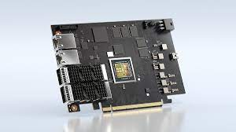
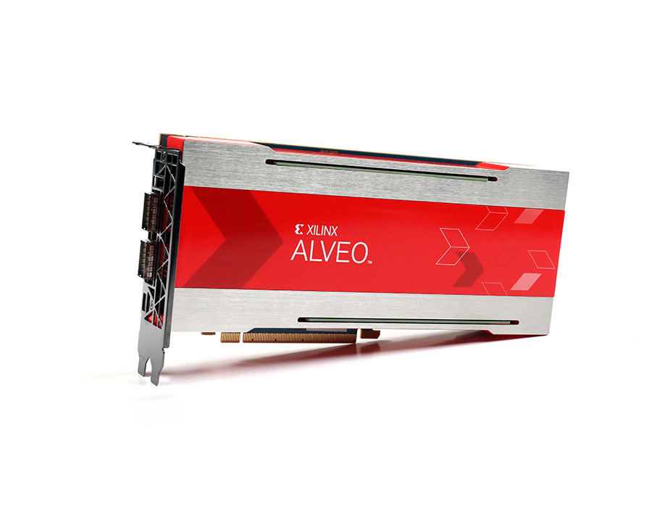
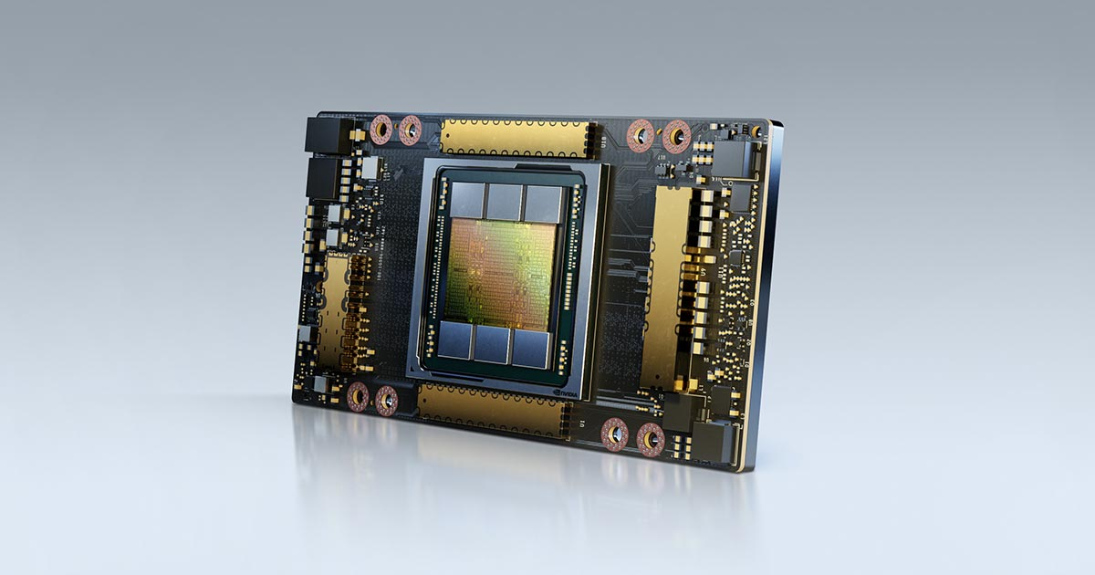
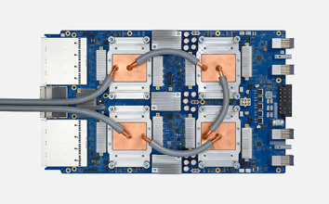
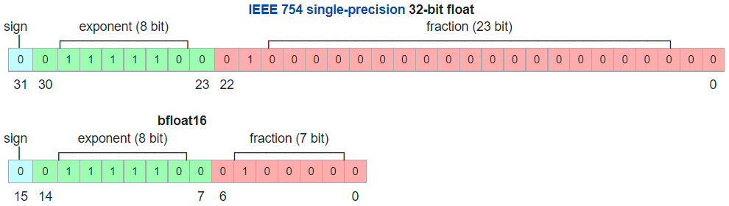
Some Examples of Hardware Accelerators
NVIDIA® BlueField®-2 data processing unit (DPU)
200Gb/s Ethernet + IB + 8 Armv8 A72 cores + accerators for encryption and hashing + NVMe storage + 32GB DDR4
Xilinx Alveo U280 Data Center Accelerator Card (FPGA)
100Gb/s Ethernet + 1,079,000 Look-up Tables (LUTs), 32GB DDR
NVIDIA A100 Tensor Core (GPU)
40GB/80GB memory, SXM dual-slot card design, 19.5 TFLOPS for FP64 Tensor Core ops and 9.7 TFLOPS for general FP64 ops
Google Tensor Processing Unit (TPU) v3
128GB memory, 4 TPUs with 2 cores each, 420 TFLOPS for Tensor Core ops, MXU (Matrix Multiply Unit) 128x128 bfloat16 matrices, VPU (Vector processing Unit) float32 and int32
Notes:
https: www.nvidia.com/en-us/networking/products/data-processing-unit/
https: www.nvidia.com/content/dam/en-zz/Solutions/Data-Center/documents/datasheet-nvidia-bluefield-2-dpu.pdf#source=PR
Double Data Rate Synchronous Dynamic Random-Access Memory
https: en.wikipedia.org/wiki/Bfloat16_floating-point_format

Slide 88
Nvidia CUDA Topics
Introduction to heterogeneous computing
Grids, offsets, Streaming Multiprocessors (SM), Warps
Memory bandwidth, DRAM
Histogram pattern, atomic operations, 1D & 2D convolution
Reductions, thread management, parallel prefix sum
IEEE-754, precision, rounding
PCI Express, PCIe links and lanes, 8/10bit encoding, DMA
Solving linear systems, speedup
Solving PDEs, finite differences, cuBLAS
cuBLAS library, LAPACK, matrix factorizations

Slide 89
Latency-oriented vs Throughput-oriented Processors
Latency-oriented: processor designed to minimize latency of operations executed in serial by a single thread. Typically, general purpose CPUs.
Throughput-oriented: processor designed to maximize total throughput achieved by multiple threads executing simultaneously (GPUs).
Because memory access and ALU operation latency is high, GPUs have many ALUs that are pipelined to increase total operation throughput
Typically, CPUs outperform GPUs for sequential tasks, while GPUs outperform CPUs for tasks that can be highly parallelized

Slide 90
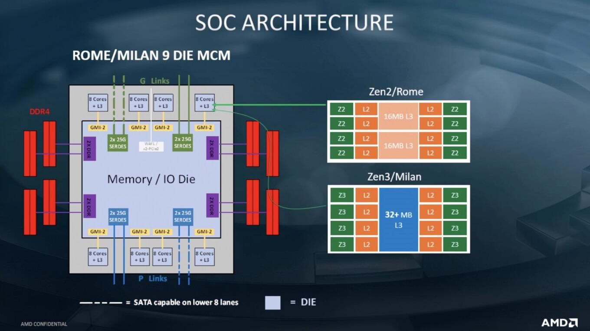
Latency-oriented vs Throughput-oriented processors
Latency-oriented: CPU is optimal for serial ops
DGX’s AMD EPYC 7742 64-Core (8x8) Processor each, with 512 MiB L3 cache
Notes:
The more cache there is, the more data can be stored closer to the CPU.
Model name: AMD EPYC 7742 64-Core Processor
L1d cache: 4 MiB
L1i cache: 4 MiB
L2 cache: 64 MiB
L3 cache: 512 MiB
Cache is graded as Level 1 (L1), Level 2 (L2) and Level 3 (L3):
L1 is usually part of the CPU chip itself and is both the smallest and the fastest to access. Its size is often restricted to between 8 KB and 64 KB.
L2 and L3 caches are bigger than L1. They are extra caches built between the CPU and the RAM. Sometimes L2 is built into the CPU with L1. L2 and L3 caches take slightly longer to access than L1. The more L2 and L3 memory available, the faster a computer can run.

Slide 91
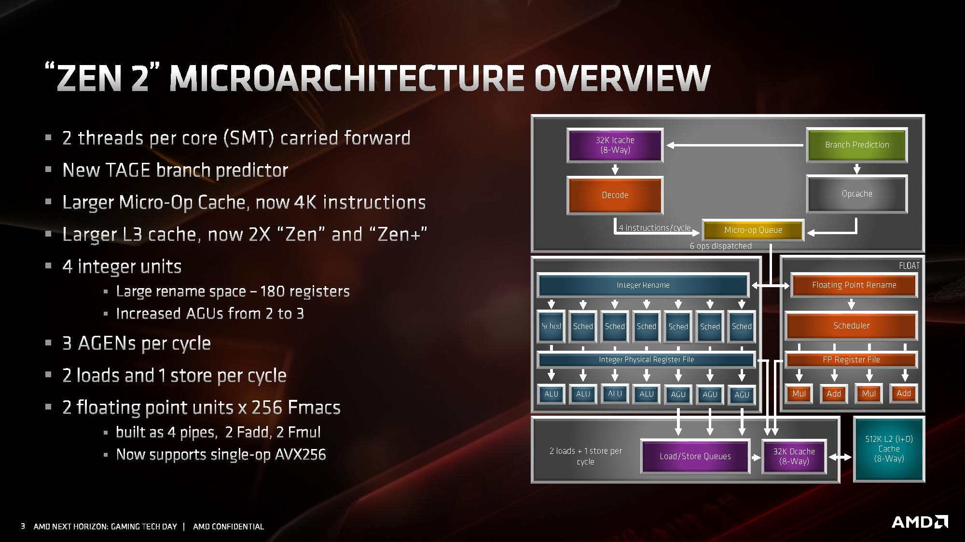
reduces branch latency
Several arithmetic logic units (ALU) and address generation units (AGU) reduce operation latency
Large (512K dedicated) L2 cache avoids long latency DRAM accesses
Notes:
https: www.anandtech.com/Show/Index/14525?cPage=21&all=False&sort=0&page=12&slug=amd-zen-2-microarchitecture-analysis-ryzen-3000-and-epyc-rome
Simultaneous multithreading (SMT)
Dynamic random-access memory (DRAM)
EPYC 7742 is a 64-bit 64-core x86 server microprocessor designed and introduced by AMD in mid-2019. This multi-chip processor, which is based on the Zen 2 microarchitecture, incorporates logic fabricated TSMC 7 nm process and I/O fabricated on GlobalFoundries 14 nm process. The 7742 has a TDP of 225 W with a base frequency of 2.25 GHz and a boost frequency of up to 3.4 GHz. This processor supports up to two-way SMP and up to 4 TiB of eight channels DDR4-3200 memory per socket.
AMD EPYC 7742 64-Core Processor
L1d cache: 4 MiB
L1i cache: 4 MiB
L2 cache: 64 MiB
L3 cache: 512 MiB

Slide 92
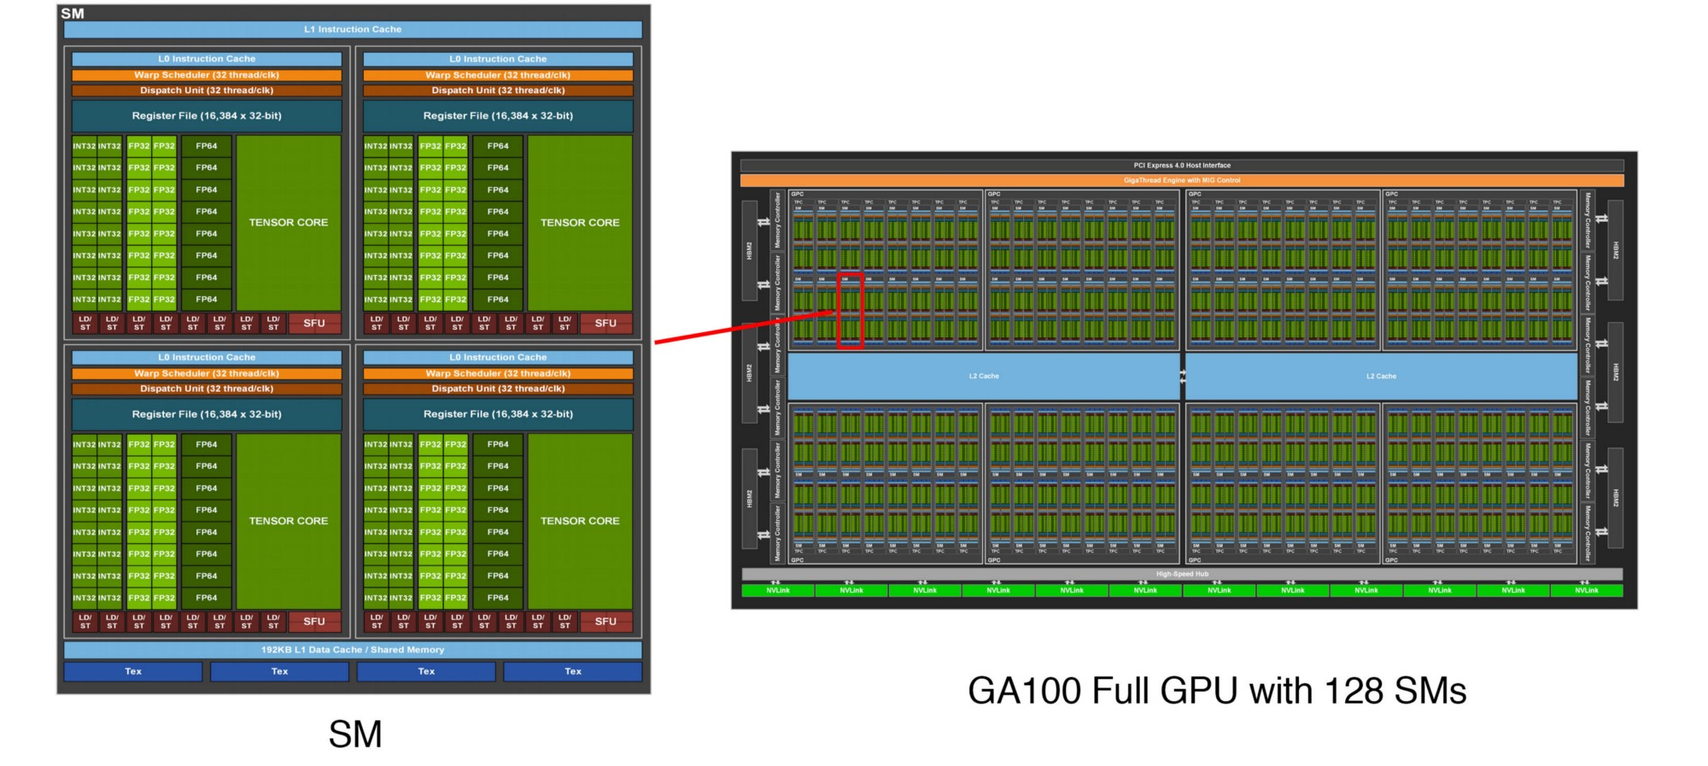
Throughput-oriented: GPU is optimal for parallel ops
No branch prediction unit, but many pipelined ALUs increase throughput
Nvidia A100 GPU contains 128 SMs
Special Function Units (SFUs) execute transcendental instructions such as sin, cosine, reciprocal, and square root. Each SFU executes one instruction per thread, per clock
Streaming Multiprocessor (SM)
Small (192K shared) cache
Notes:
https: jonathan-hui.medium.com/ai-chips-a100-gpu-with-nvidia-ampere-architecture-3034ed685e6e

Slide 93
Recall the Row-Major Layout of a 2D Array
[0][0] | [0][1] | [0][2]
[1][0] | [1][1] | [1][2]
[2][0] | [2][1] | [2][2]
[0][0] | [0][1] | [0][2] | [1][0] | [1][1] | [1][2] | [2][0] | [2][1] | [2][2]
0 | 1 | 2 | 3 | 4 | 5 | 6 | 7 | 8
Zero-based numbering; initial element is assigned the index 0

Slide 94

Grid of Threads
Execution on a GPU is performed by a grid (2D array) of threads indexed by a row block index and a column thread index
thread 0 | thread 1 | thread 2 |  |  |  |  |  |  | thread i_{col}
block 0
block 1
block 2
block i_{row}
blockDim is the number of threads in a block

Slide 95
Thread to Data Mapping
General strategy is to associate each datum to a separate thread on a grid.
Consider problem of adding two vectors c[N] = a[N] + b[N]
a[0] | a[1] | a[2] | a[3] | · · · | a[N-1]
Define kernel that executes on grid
All threads execute the same kernel instructions
Single Program Multiple Data (SPMD) Flynn taxonomy
Map operation of assigning c[i] = a[i] + b[i] to thread i where
→c[0] | →c[1] | →c[2] | →c[3] | · · · | →c[N-1]
b[0] | b[1] | b[2] | b[3] | · · · | b[N-1]

Slide 96
Vector Addition
If vector dimension > block dimension, multiple compute solution
thread 0 | thread 1 | thread 2 |  |  |  | thread i_{col}
block 0
block 1
block 2
block 0 adds first blockDim elements of a[] and b[], elements 0 through blockDim - 1
block 1 adds second blockDim elements of a[] and b[], elements blockDim through blockDim + blockDim - 1
block i_{row}
block i adds elements i х blockDim through i х blockDim + blockDim - 1

Slide 97
Example Kernel: assign a[i] = i
cp /usr/local/compe160/ManagedArray.cu $HOME/compe160
nvcc ManagedArray.cu -O3 -c
nvcc ManagedArray.cu -O3 -o ManagedArray
./ManagedArray
allocate managed integer array a[4097]
invoke kernel with 33 blocks and 128 threads
a[0] = 0
a[1] = 1
a[2] = 2
a[3] = 3
a[4] = 4
a[5] = 5
a[6] = 6
.
.
.

Slide 98
ManagedArray Driver
int main() {
int N=4097;
int threads=128;
int blocks=(N+threads-1)/threads; 33 blocks indexed 0 to 32
int *a;
printf("allocate managed integer array a[%d]\n",N);
cudaMallocManaged(&a,N*sizeof(int));
printf("invoke kernel with %d blocks and %d threads\n",blocks,threads);
kernel<<<blocks,threads>>>(a, N);
cudaDeviceSynchronize();
for(int i=0;i<=4223;i++)
printf("a[%d] = %d\n",i,a[i]);
cudaFree(a);
cudaCheckError();
return 0;
}
4097/128 = 32.0078125; 4224 / 128 = 33; 4224 – 4097 = 127, so we need an additional (threads-1) blocks
Allocate Unified Memory accessible from CPU or GPU
Barrier: make GPU memory and system memory state consistent
32 х 128 + 127 = 4223
Free allocated Unified Memory so it can be reused
With Unified Memory, the GPU hardware automatically migrates GPU memory pages to the system memory of the accessing CPU
Notes:
4097/128 = 32.0078125; 4224 / 128 = 33; 4224 – 4097 = 127, so we need an additional threads-1 blocks
https://developer.nvidia.com/blog/unified-memory-cuda-beginners/

Slide 99
Kernel implementation
__global__ void kernel(int *a, int N) {
// blockDim.x = 128
// blockIdx.x ranges from [0,32]
// threadIdx.x ranges from [0,127]
int i=blockIdx.x*blockDim.x+threadIdx.x; // 1D offset
a[i]=i; // i ranges from 0 to 4223
}

Slide 100
Useful cudaCheckError macro
#define cudaCheckError() { \
cudaError_t e=cudaGetLastError(); \
if(e!=cudaSuccess) { \
printf("Cuda failure %s:%d: '%s'\n",__FILE__,__LINE__,cudaGetErrorString(e)); \
exit(EXIT_FAILURE); \
} \
}

Slide 101

NVIDIA Nsight Systems Profiler
/usr/local/compe160:
Windows: NsightSystems-2021.5.1.118-f89f9cd.msi
Linux (Debian/Ubuntu) NsightSystems-linux-public-2021.5.1.118-f89f9cd.deb
macOS: NsightSystems-macos-public-2021.5.1.118-f89f9cd.dmg

Slide 102
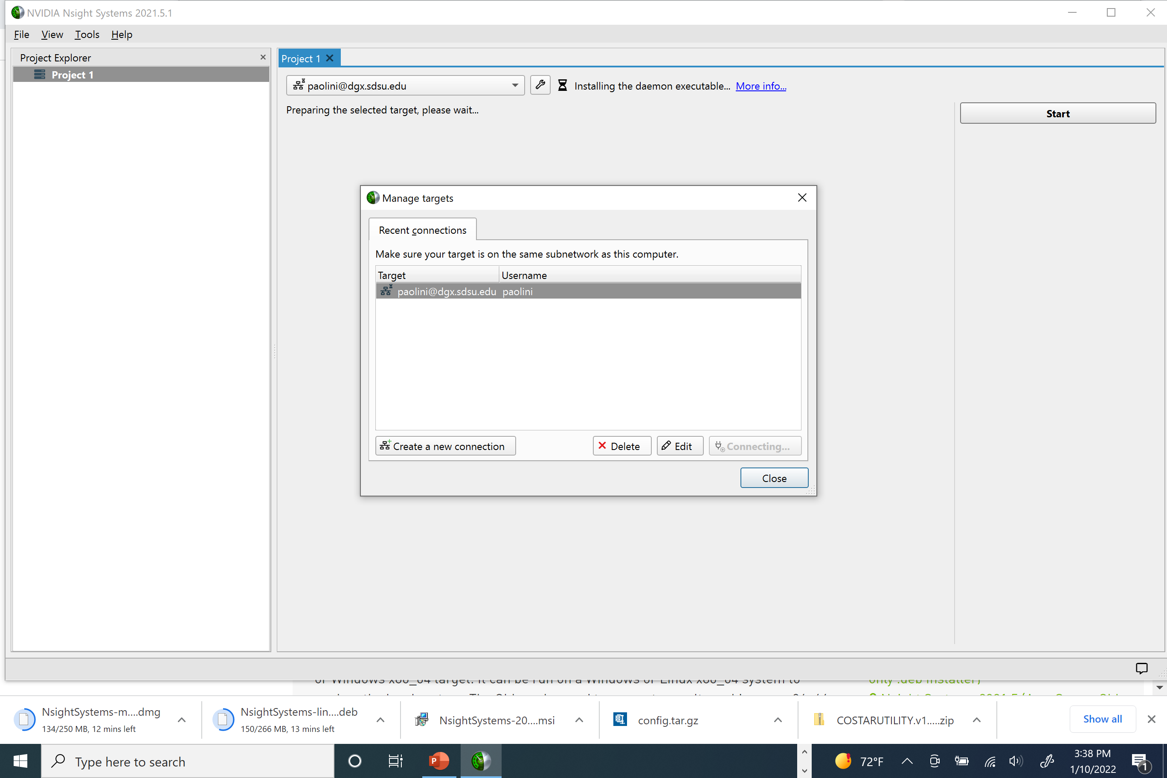
NVIDIA Nsight Systems Profiler

Slide 103
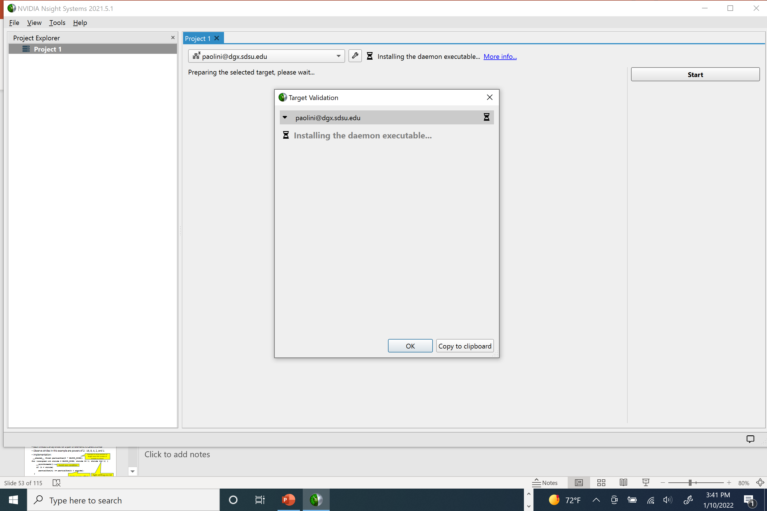
NVIDIA Nsight Systems

Slide 104
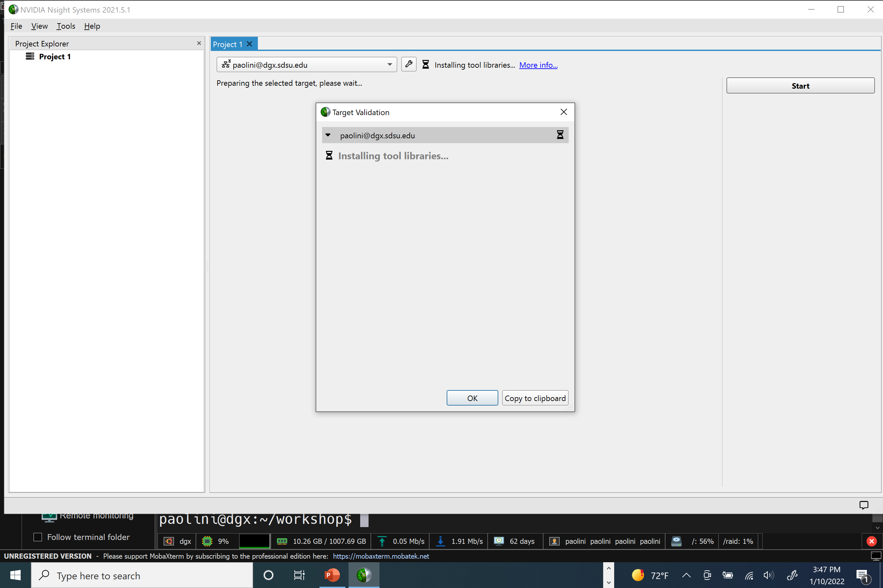
NVIDIA Nsight Systems

Slide 105
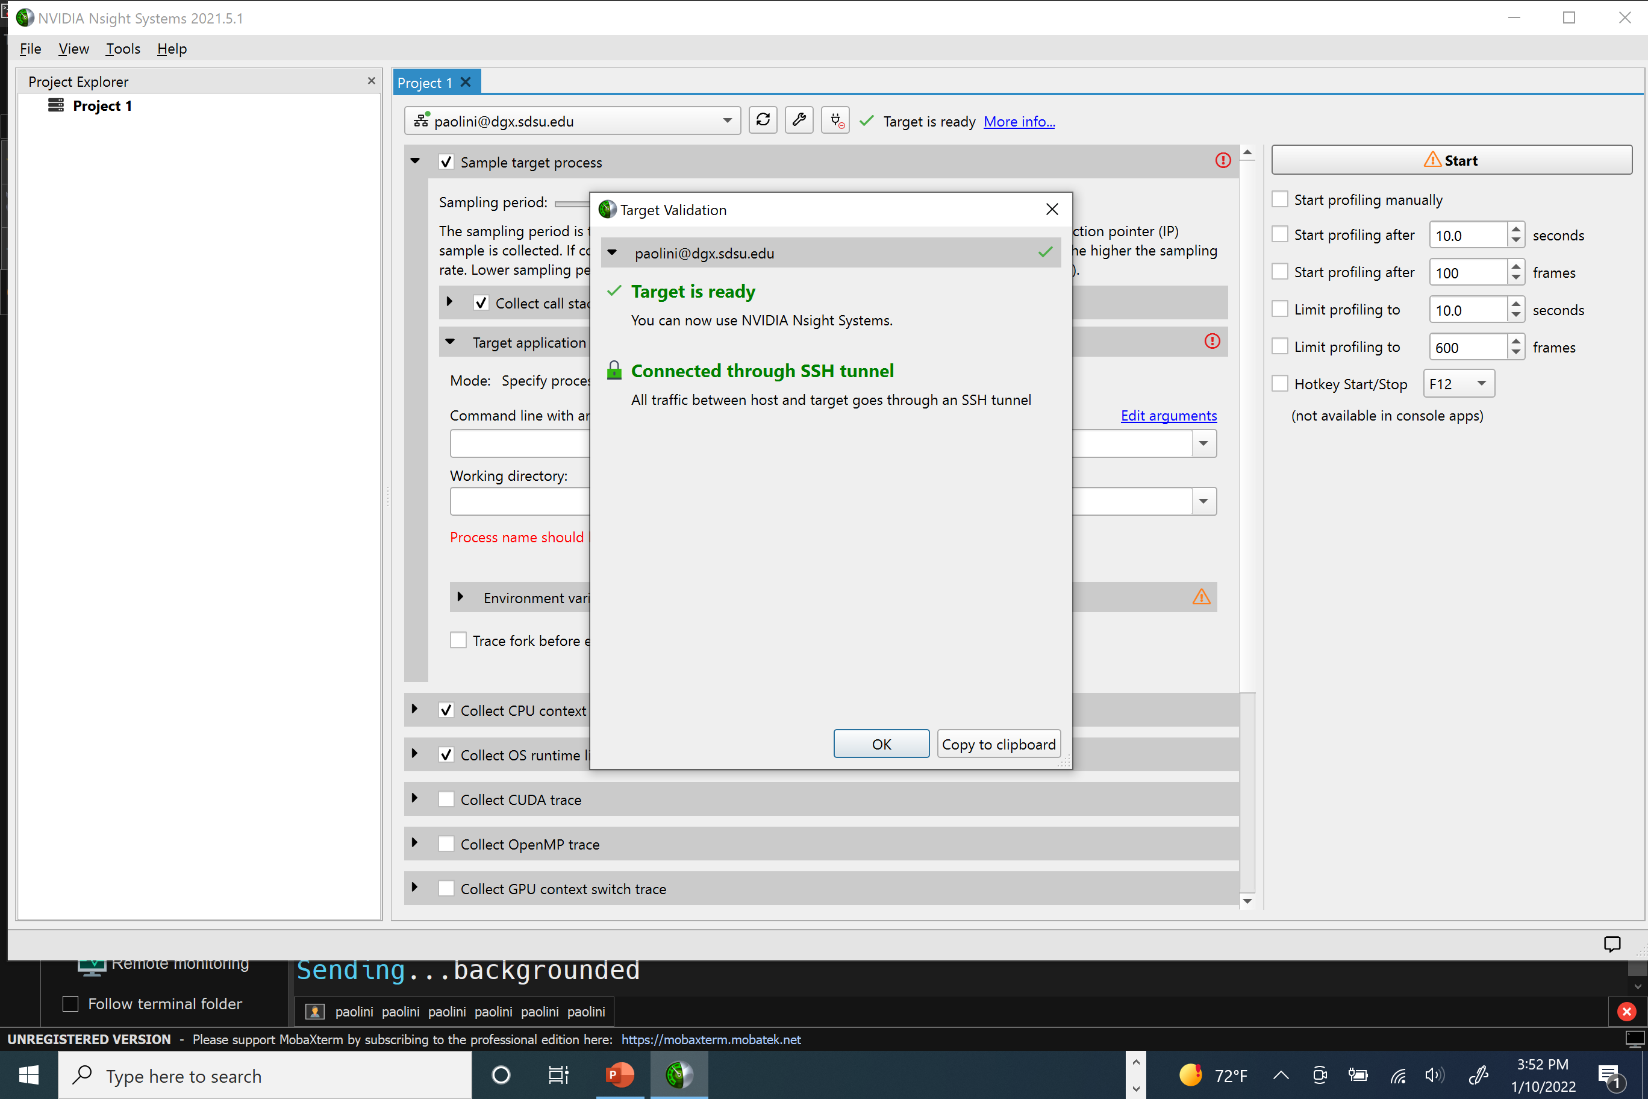
NVIDIA Nsight Systems

Slide 106
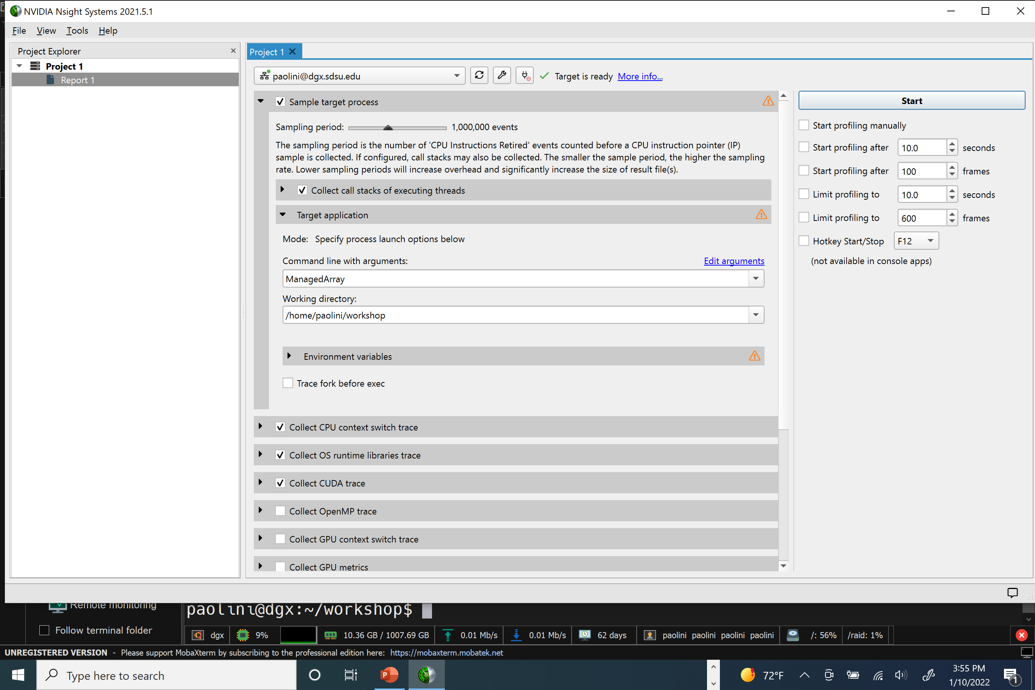
NVIDIA Nsight Systems

Slide 107
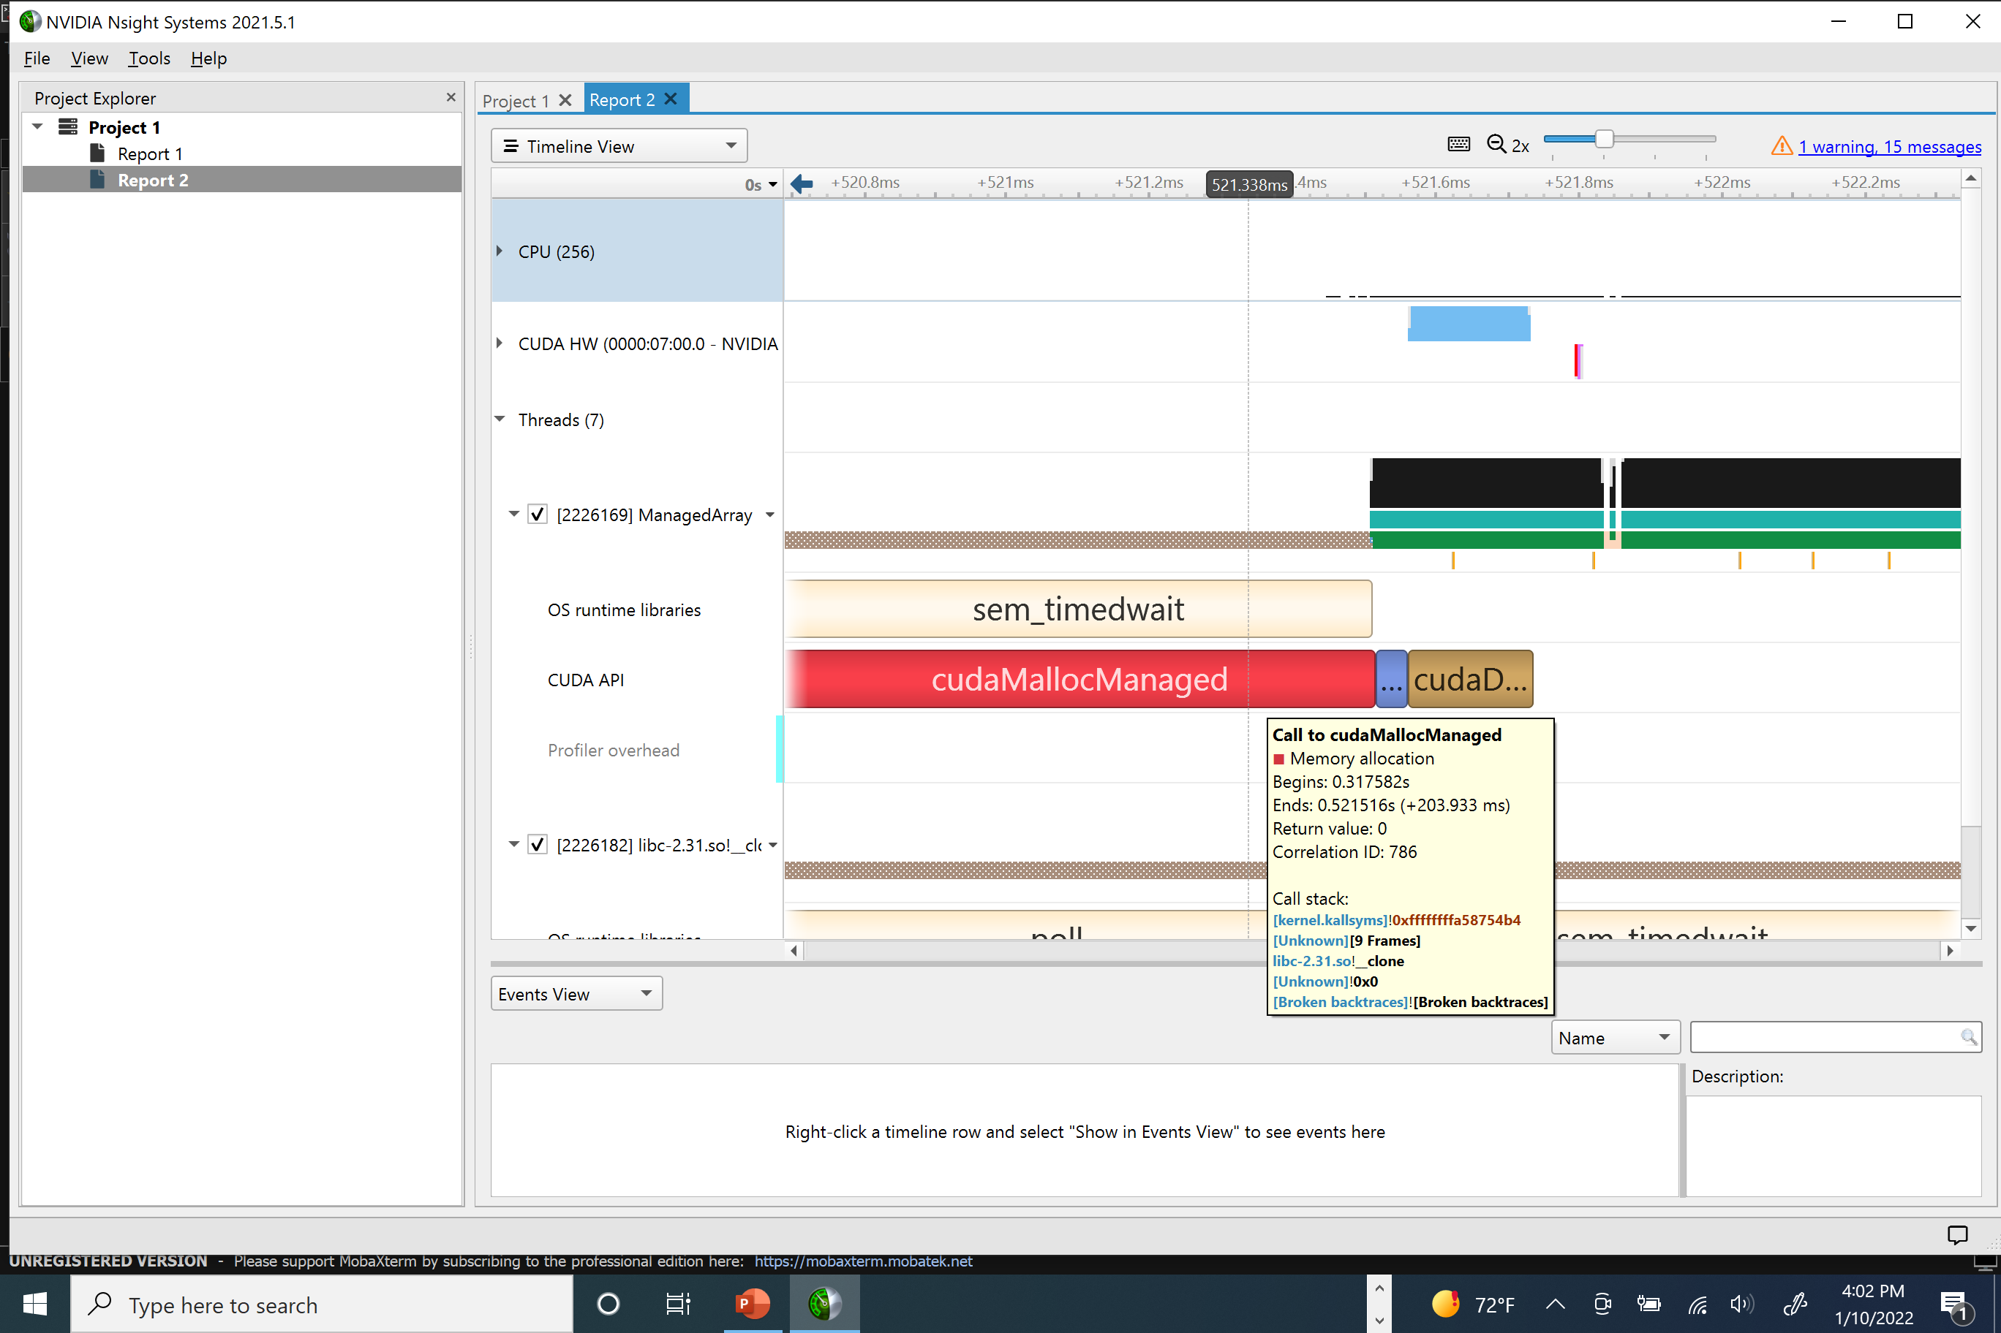
NVIDIA Nsight Systems

Slide 108
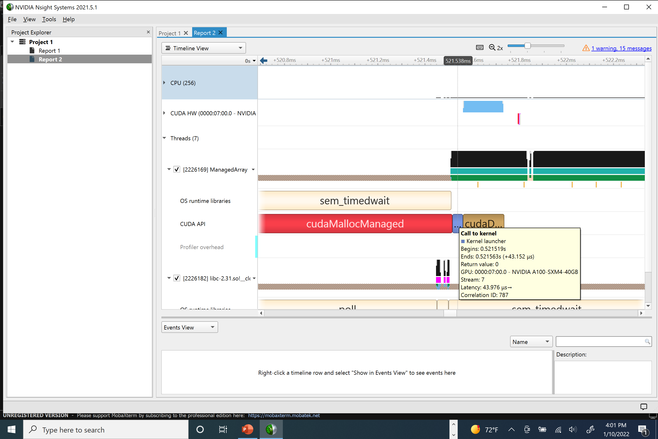
NVIDIA Nsight Systems

Slide 109
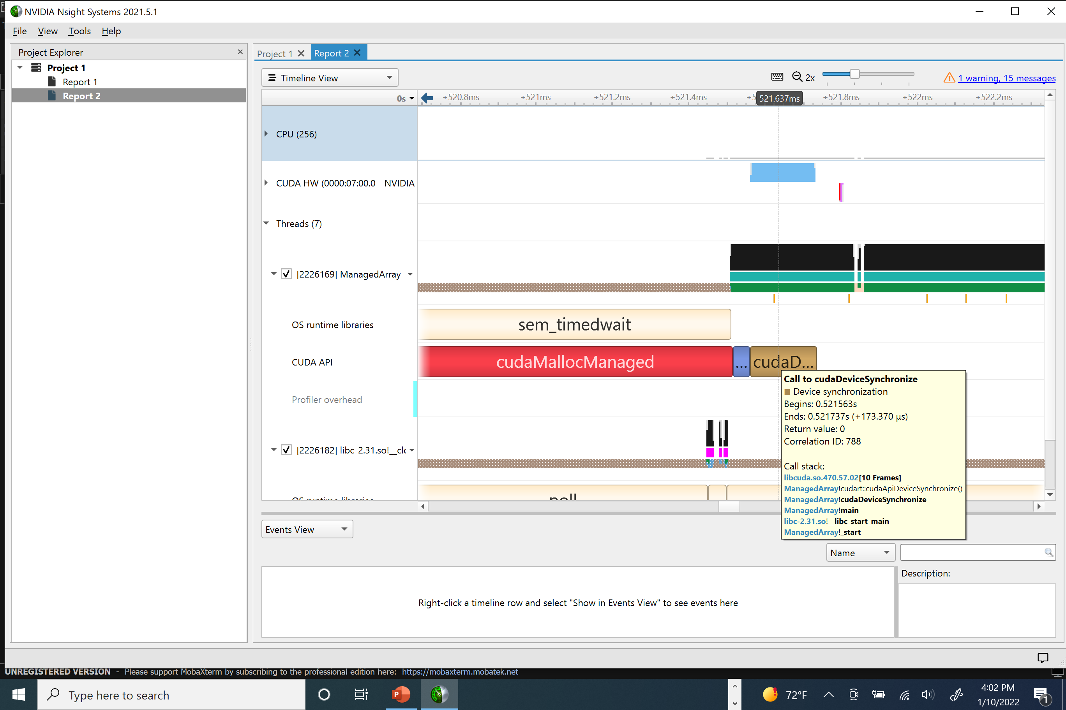
NVIDIA Nsight Systems

Slide 110
Parallel reduction
Consider the summation of an array of 32 elements
First summation uses 16 (i.e., N/2) threads to sum 16 different pairs
0 | 1 | 2 | 3 | 4 | 5 | 6 | 7 | 8 | 9
10 | 11 | 12 | 13 | 14 | 15 | 16 | 17 | 18 | 19
20 | 21 | 22 | 23 | 24 | 25 | 26 | 27 | 28 | 29
30 | 31

Slide 111
Parallel reduction
Consider the summation of an array of 32 elements
i^{th} summation uses N/2^{i} threads to sum i different pairs
0 | 1 | 2 | 3 | 4 | 5 | 6 | 7 | 8 | 9
0 | 1 | 2 | 3 | 4 | 5 | 6 | 7 | 8 | 9
log₂N = log₂32 = 5
Fourth
Fifth
Final sum per block in element with index 0

Slide 112
GPU Parallel reduction
Each thread’s array offset for a pair of elements is called a stride
Observe strides in this example are powers of 2: 16, 8, 4, 2, and 1
Implementation:
__shared__ float partialSum[2 * BLOCK_SIZE];
for (unsigned int stride = BLOCK_SIZE; stride >= 1; stride >>= 1) {
__syncthreads();
if (t < stride)
partialSum[t] += partialSum[t + stride];
}
Operate on array partition of length twice the number of threads in a block
Avoid race condition of prior pairwise sum
Stride is array offset
Right shifting one bit half’s the stride value

Slide 113
Parallel reduction complete kernel
#define BLOCK_SIZE 512 @@ You can change this
__global__ void total(float *input, float *output, int len) {
__shared__ float partialSum[2 * BLOCK_SIZE];
unsigned int t = threadIdx.x, start = 2 * blockIdx.x * BLOCK_SIZE;
if (start + t < len)
partialSum[t] = input[start + t];
else
partialSum[t] = 0;
if (start + BLOCK_SIZE + t < len)
partialSum[BLOCK_SIZE + t] = input[start + BLOCK_SIZE + t];
else
partialSum[BLOCK_SIZE + t] = 0;
for (unsigned int stride = BLOCK_SIZE; stride >= 1; stride >>= 1) {
__syncthreads();
if (t < stride)
partialSum[t] += partialSum[t + stride];
}
if (t == 0)
output[blockIdx.x] = partialSum[0];
}
Initialize GPU memory array with input array data

Slide 114
Parallel reduction host code
float *hostInput, *hostOutput, *deviceInput, *deviceOutput;
int numInputElements, numOutputElements;
hostInput = (float *)malloc(numInputElements * sizeof(float));
for(size_t i = 0; i < numInputElements; ++i) hostInput[i] = (float) i + 1;
cudaMalloc(&deviceInput, sizeof(float) * numInputElements);
numOutputElements = numInputElements / (BLOCK_SIZE << 1);
cudaMalloc(&deviceOutput, sizeof(float) * numOutputElements);
cudaMemcpy(deviceInput, hostInput, sizeof(float) * numInputElements, cudaMemcpyHostToDevice);
dim3 dimGrid(numOutputElements, 1, 1);
dim3 dimBlock(BLOCK_SIZE, 1, 1);
total<<<dimGrid, dimBlock>>>(deviceInput, deviceOutput, numInputElements);
cudaDeviceSynchronize();
cudaMemcpy(hostOutput, deviceOutput, sizeof(float) * numOutputElements, cudaMemcpyDeviceToHost);
cudaFree(deviceInput);
cudaFree(deviceOutput);
free(hostOutput);
free(hostInput);

Slide 115
Parallel reduction host code
paolini@dgx:~/compe160$ nvcc reduction.cu -o reduction
paolini@dgx:~/compe160$ ./reduction 1024
1024 elements
Creating random input data on host
numInputElements: 1024
numOutputElements: 1
BLOCK_SIZE: 512
Each thread block takes 2*BlockDim.x = 1024 input elements
adjusted numOutputElements: 1
Allocating GPU memory
Copying input memory to the GPU
Performing CUDA computation
device elapsed time : 0.033568 ms
Copying output memory to the CPU
Sum via GPU reduction: 524800
host elapsed time : 0.004000 ms
Sum via host iteration 524800
Free GPU Memory

Slide 116
Parallel reduction
How long must an array be (as a power of 2) to see a runtime improvement? (i.e., for which value of N (a power of 2) will elapsed time for host (CPU) summation exceed elapsed time for device (GPU) summation?)

Slide 117
The cuBLAS API
BLAS (Basic Linear Algebra Subprograms)
Reference: http: www.netlib.org/blas/
API provides three levels of functions to perform operations on scalars, vectors, and matrices
Level 1: scalar, vector, and vector-vector operations
Level 2: matrix-vector operations
Level 3: matrix-matrix operations
BLAS API uses by many higher-layer APIs (e.g., LAPACK)

Slide 118
Level 1: scalar, vector, and vector-vector operations
First character of function identifies data type: S, D, C, or Z
S: single precision floating point
D: double precision floating point
C: complex, single precision
Z: complex, double precision
sign
exponent (8b)
fraction (23b)
31 | 30 |  |  |  |  |  |  | 23 | 22 |  |  |  |  |  |  |  |  |  |  |  |  |  |  |  |  |  |  |  |  |  | 0
exponent (11b)
fraction (52b)
63 | 62 |  |  |  |  |  |  |  |  |  | 52 | 51 |  |  |  |  |  |  |  |  |  |  |  |  |  |  |  |  |  |  |  |  |  |  |  |  |  |  |  |  |  |  |  |  |  |  |  |  |  |  |  |  |  |  |  |  |  |  |  |  |  |  | 0

Slide 119
Level 1: scalar, vector, and vector-vector operations
Examples:
SDOT forms the dot product of two vectors:
float sdot(const MKL_INT *n, const float *x, const MKL_INT *incx, const float *y, const MKL_INT *incy)
SNRM2 returns the Euclidean norm of a vector
float snrm2(const MKL_INT *n, const float *x, const MKL_INT *incx)
SAXPY returns a constant times a vector x plus a vector y = a*x + y
void saxpy(const MKL_INT *n, const float *alpha, const float *x, const MKL_INT *incx, float *y, const MKL_INT *incy)

Slide 120
Level 2: matrix-vector operations
Example
SGEMV performs matrix vector multiply y = alpha*A*x + beta*y
void sgemv(const char *trans, const MKL_INT *m, const MKL_INT *n, const float *alpha, const float *a, const MKL_INT *lda, const float *x, const MKL_INT *incx, const float *beta, float *y, const MKL_INT *incy)
If trans == ‘T’ compute y = alpha*A^{T}*x + beta*y
If trans == ‘N’ compute y = alpha*A*x + beta*y

Slide 121
Level 2: matrix-vector operations
Example
SGEMV performs matrix vector multiply y = alpha*A*x + beta*y
void sgemv(const char *trans, const MKL_INT *m, const MKL_INT *n, const float *alpha, const float *a, const MKL_INT *lda, const float *x, const MKL_INT *incx, const float *beta, float *y, const MKL_INT *incy)
m: number of rows of the matrix A
n: number of columns of the matrix A
alpha: scalar coefficient for x
a: 2D array of dimension [LDA][N]
lda: leading dimension of array a equal to max( 1, m )
x: array of dimension ( 1 + ( n - 1 )*abs( incx ) ) when TRANS = ‘N’ or ( 1 + ( m - 1 )*abs( incx ) ) when TRANS = ‘T’
y: array of dimension ( 1 + ( m - 1 )*abs( incx ) ) when TRANS = ‘N’ or ( 1 + ( n - 1 )*abs( incx ) ) when TRANS = ‘T’
incx: increment for the elements of array x
incy: increment for the elements of array y
beta: scalar coefficient for y

Slide 122
Level 3: matrix-matrix operations
Example
SGEMM matrix-matrix multiply, performs C = alpha * A * B + beta * C
void cblas_sgemm(const CBLAS_LAYOUT Layout, const CBLAS_TRANSPOSE TransA, const CBLAS_TRANSPOSE TransB, const MKL_INT M, const MKL_INT N, const MKL_INT K, const float alpha, const float *A, const MKL_INT lda, const float *B, const MKL_INT ldb, const float beta, float *C, const MKL_INT ldc)
TRANSA
TRANSB
M: number of rows of the matrix A and of the matrix C
N: number of columns of matrix B and matrix C
K: number of columns of the matrix A and the number of rows of the matrix B
Alpha
A
LDA: When TRANSA = 'N' or 'n' then LDA must be at least max( 1, m ), otherwise LDA must be at least max( 1, k )
B
LDB: When TRANSB = 'N' or 'n' then LDB must be at least max( 1, k ), otherwise LDB must be at least max( 1, n )
Beta
C
LDC: must be at least max( 1, m )

Slide 123
Memory Layout of a Matrix
[0][0] | [0][1] | [0][2] | [0][3]
[1][0] | [1][1] | [1][2] | [1][3]
[2][0] | [2][1] | [2][2] | [2][3]
Row-major layout
Offset index k for element [i][j]
k = i * N + j
A_{3x4} =
k
[0][0] | [0][1] | [0][2] | [0][3] | [1][0] | [1][1] | [1][2] | [1][3] | [2][0] | [2][1] | [2][2] | [2][3]
0 | 1 | 2 | 3 | 4 | 5 | 6 | 7 | 8 | 9 | 10 | 11

Slide 124
Memory Layout of a Matrix
[0][0] | [0][1] | [0][2] | [0][3]
[1][0] | [1][1] | [1][2] | [1][3]
[2][0] | [2][1] | [2][2] | [2][3]
Column-major layout
Offset index k for element [i][j]
k = j * M + i
A_{3x4} =
k
[0][0] | [1][0] | [2][0] | [0][1] | [1][1] | [2][1] | [0][2] | [1][2] | [2][2] | [0][3] | [1][3] | [2][3]
0 | 1 | 2 | 3 | 4 | 5 | 6 | 7 | 8 | 9 | 10 | 11

Slide 125
The cuBLAS API
Implementation of level 1, 2, and 3 operations on a GPU
Uses column major order with 1 indexing
Preserves compatibility with Fortran numeric libraries, but different then C/C++ which uses row major order with 0 indexing

Slide 126
The cuBLAS API: creating a context
step 1: create cublas handle to store an execution context
cublasHandle_t cublasH = NULL;
cublasStatus_t status = CUBLAS_STATUS_SUCCESS;
status = cublasCreate(&cublasH);
execution context stores internal resources.
context needs to be created before executing any cuBLAS routine

Slide 127
The cuBLAS API
if( CUBLAS_STATUS_SUCCESS != status)
{
switch(status)
{
case CUBLAS_STATUS_NOT_INITIALIZED:
fprintf(stderr,"the CUDA Runtime initialization failed.\n");
break;
case CUBLAS_STATUS_ALLOC_FAILED:
fprintf(stderr,"cuBLASCreate: the resources could not be allocated..\n");
break;
case CUBLAS_STATUS_ARCH_MISMATCH:
fprintf(stderr,"cuBLASDnCreate: the device only supports compute capability 2.0 and above.\n");
break;
case CUBLAS_STATUS_INTERNAL_ERROR:
// https: docs.nvidia.com/cuda/cuBLAS/index.html
fprintf(stderr,"cuBLASDnCreate: an internal cuBLAS operation failed. This error is usually caused by a cudaMemcpyAsync() failure. To correct: check that the hardware, an appropriate version of the driver, and the cuBLAS library are correctly installed. Also, check that the memory passed as a parameter to the routine is not being deallocated prior to the routine’s completion.\n");
break;
default:
fprintf(stderr,"cuBLASDnCreate: unknown error (%d).\n", status);
break;
}
exit(1);
}

Slide 128
The cuBLAS API: create and set a stream
step 2 is to create a set a stream
status = cudaStreamCreateWithFlags(&stream, cudaStreamNonBlocking);
assert(cudaSuccess == status);
status = cublasSetStream(cublasH, stream);
assert(CUBLAS_STATUS_SUCCESS == status);

Slide 129
The cuBLAS API: destroying a context
Final step is to free the memory allocated to the context after all cuBLAS operations have completed
if (cublasH ) cublasDestroy(cublasH);
cublasCreate and cublasDestroy are relatively expensive operations so cuBLAS operations should be grouped together as much as possible

Slide 130
The cuBLAS API: naming convention
Prefix conventional BLAS function with string cublas and capitalize datatype character identifier
Examples
sdot becomes cublasSdot
snrm2 becomes cublasSnrm2
saxpy becomes cublasSaxpy (returns y[i] = a*x[i] + y[i])

Slide 131
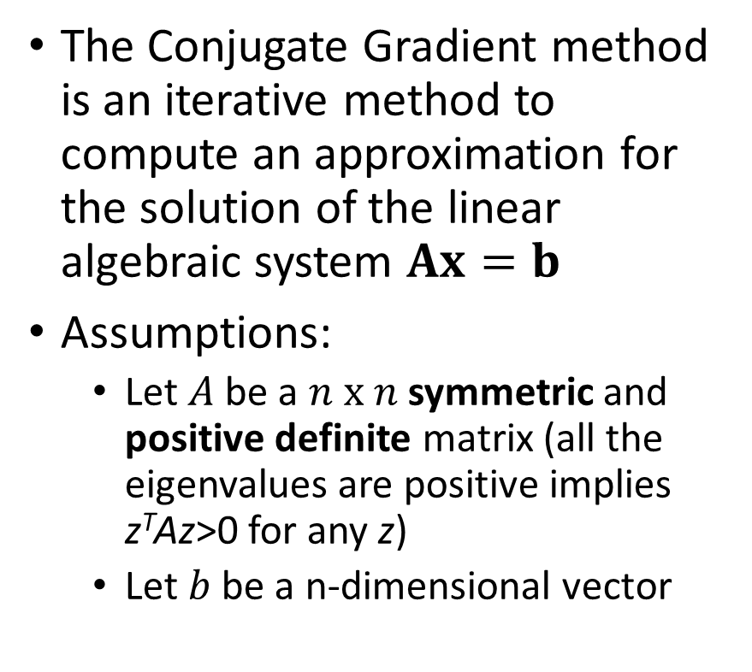
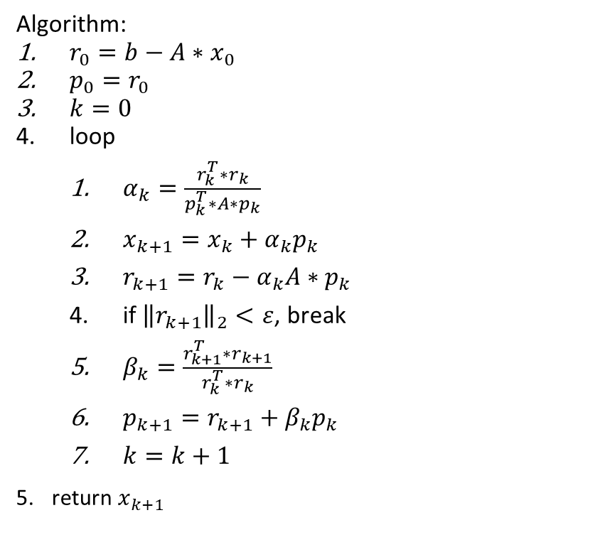
Conjugate Gradient Method Example
The Conjugate Gradient method is an iterative method to compute an approximation for the solution of the linear algebraic system $Ax=b$
Assumptions:
Let $A$ be a $n x n$ symmetric and positive definite matrix (all the eigenvalues are positive implies z^{T}Az>0 for any z)
Let $b$ be a n-dimensional vector
Algorithm:
$r_{0}=b−A∗x_{0}$
$p_{0}=r_{0}$
$k=0$
loop
$α_{k}=\frac{r_{k}^{T}∗r_{k}}{p_{k}^{T}∗A∗p_{k}}$
$x_{k+1}=x_{k}+α_{k}p_{k}$
$r_{k+1}=r_{k}−α_{k}A∗p_{k}$
if ${\left\|r_{k+1}\right\|}_{2}<ε$, break
$β_{k}=\frac{r_{k+1}^{T}∗r_{k+1}}{r_{k}^{T}∗r_{k}}$
$p_{k+1}=r_{k+1}+β_{k}p_{k}$
$k=k+1$
return $x_{k+1}$
New guess of minima along direction p_{k}
New search direction

Slide 132

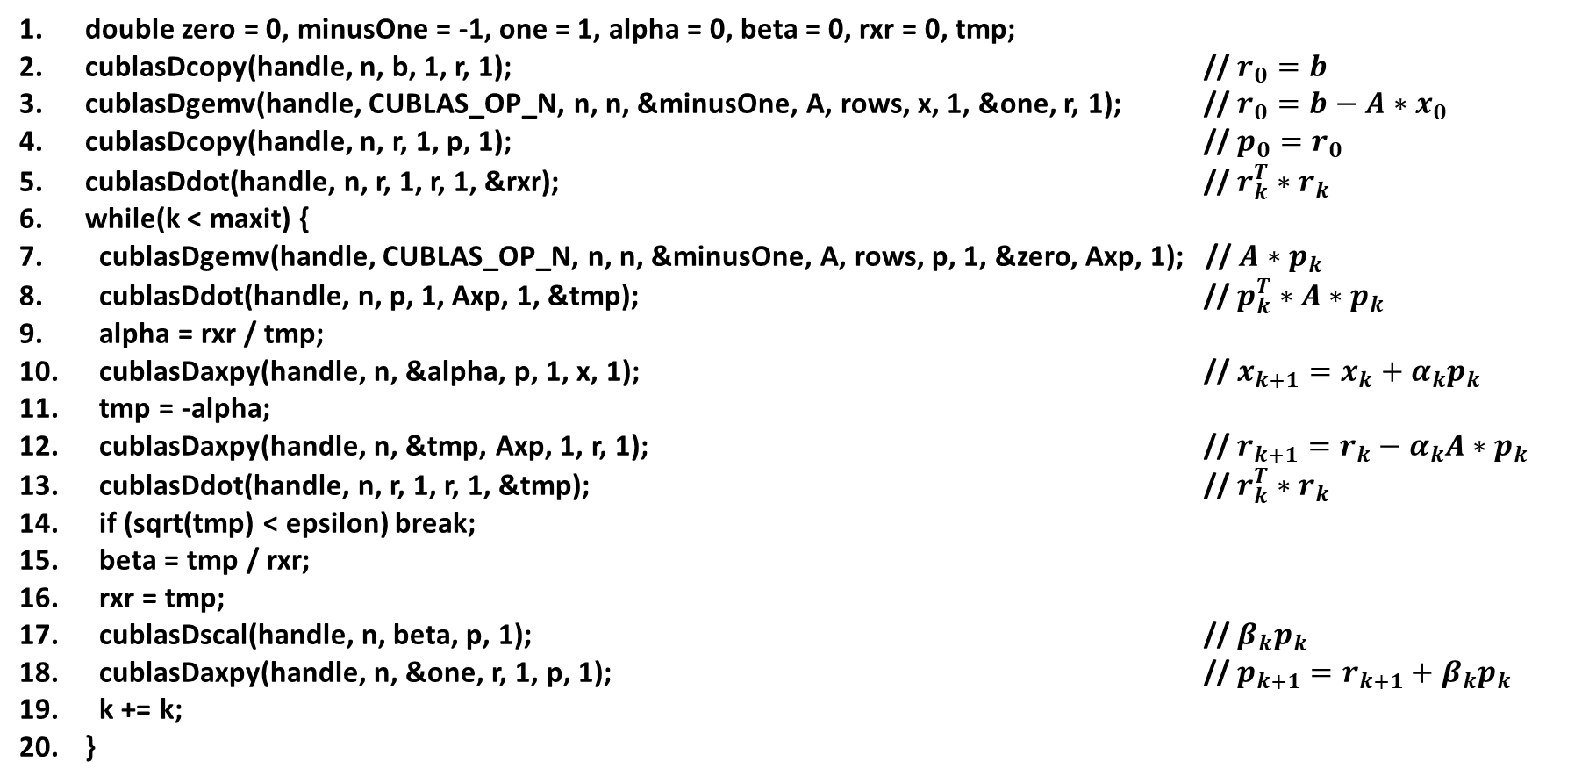
cuBLAS implementation of the Conjugate Gradient method
double zero = 0, minusOne = -1, one = 1, alpha = 0, beta = 0, rxr = 0, tmp;
cublasDcopy(handle, n, b, 1, r, 1); // $r_{0}=b$
cublasDgemv(handle, CUBLAS_OP_N, n, n, &minusOne, A, rows, x, 1, &one, r, 1); // $r_{0}=b−A∗x_{0}$
cublasDcopy(handle, n, r, 1, p, 1); // $p_{0}=r_{0}$
cublasDdot(handle, n, r, 1, r, 1, &rxr); // $r_{k}^{T}∗r_{k}$
while(k < maxit) {
cublasDgemv(handle, CUBLAS_OP_N, n, n, &minusOne, A, rows, p, 1, &zero, Axp, 1); // $A∗p_{k}$
cublasDdot(handle, n, p, 1, Axp, 1, &tmp); // $p_{k}^{T}∗A∗p_{k}$
alpha = rxr / tmp;
cublasDaxpy(handle, n, &alpha, p, 1, x, 1); // $x_{k+1}=x_{k}+α_{k}p_{k}$
tmp = -alpha;
cublasDaxpy(handle, n, &tmp, Axp, 1, r, 1); // $r_{k+1}=r_{k}−α_{k}A∗p_{k}$
cublasDdot(handle, n, r, 1, r, 1, &tmp); // $r_{k}^{T}∗r_{k}$
if (sqrt(tmp) < epsilon) break;
beta = tmp / rxr;
rxr = tmp;
cublasDscal(handle, n, beta, p, 1); // $β_{k}p_{k}$
cublasDaxpy(handle, n, &one, r, 1, p, 1); // $p_{k+1}=r_{k+1}+β_{k}p_{k}$
k += k;
}

Slide 133
Solving linear systems
Suppose we wish to solve a linear system
We can express this system in the matrix-vector form Ax = b where

Slide 134
LU factorization
One method to solve such a system is to factor the matrix A into separate lower and upper triangular matrixes L and U, respectively:
Once the L and U factors are obtained, the desired solution vector x can be found as follows

Slide 135
CUDA LU factorization and solver example
Lab exercise: modify the LU factorization and solver code to solve the following simple linear system:
Template code starting point: /usr/local/compe160/luTemplate.cpp

Slide 136

Reduction Example: Riemann summation
Lab exercise: implement LU factorization with partial pivoting to solve the simple linear system on the Nvidia A100 GPU:
Template code starting point:
/usr/local/compe160/luTemplate.cpp
$$\left[\begin{matrix}1 & 2 & −1 \\ 2 & 2 & 2 \\ 1 & −1 & 2\end{matrix}\right]\left[\begin{matrix}x_{1} \\ x_{2} \\ x_{3}\end{matrix}\right]=\left[\begin{matrix}2 \\ 12 \\ 5\end{matrix}\right]$$

Slide 137
Dramadah matrix
Suppose we wish to factor the 6x6 Dramadah matrix
A Dramadah matrix is a matrix of ones and zeroes whose inverse has integer entries.

Slide 138
Identity I

Slide 139
Matrix Triangularization
Consider 3x3 coefficient matrix A
We wish to reduce A to upper triangular form by adding to each row i a multiple of row i-1 for i > 1, such that the elements in columns 1 through i-1 are 0.
Example upper triangular form of A
2 | 3 | 4
5 | 6 | 7
8 | 9 | 8
2 | 3 | 4
0 | -1.5 | -3
0 | 0 | -2

Slide 140
Matrix Triangularization
Example sequence of row operations to zero column 1 in rows 2 and 3
a[2][3] -= a[1][3] * a[2][1]/a[1][1]
7.00 -= 4.00 * 5.00/2.00
a[2][2] -= a[1][2] * a[2][1]/a[1][1]
6.00 -= 3.00 * 5.00/2.00
a[2][1] -= a[1][1] * a[2][1]/a[1][1]
5.00 -= 2.00 * 5.00/2.00
a[3][3] -= a[1][3] * a[3][1]/a[1][1]
8.00 -= 4.00 * 8.00/2.00
a[3][2] -= a[1][2] * a[3][1]/a[1][1]
9.00 -= 3.00 * 8.00/2.00
a[3][1] -= a[1][1] * a[3][1]/a[1][1]
8.00 -= 2.00 * 8.00/2.00
2 | 3 | 4
5 | 6 | 7
8 | 9 | 8
Update row i by subtracting multiple of row i-i
Row factor
Initial system
Zero column 1 in row 2
2 | 3 | 4
0 | -1.5 | -3
0 | -3 | -8
Zero column 1 in row 3
System after zeroing column 1

Slide 141
Matrix Triangularization
Example sequence of row operations to zero column 2 in row 3
a[3][3] -= a[2][3] * a[3][2]/a[2][2]
-8.00 -= -3.00 * -3.00/-1.50
a[3][2] -= a[2][2] * a[3][2]/a[2][2]
-3.00 -= -1.50 * -3.00/-1.50
2 | 3 | 4
0 | -1.5 | -3
0 | -3 | -8
Update row i by subtracting multiple of row i-i
Row factor
Initial system
Zero column 2 in row 3
2 | 3 | 4
0 | -1.5 | -3
0 | 0 | -2
System after zeroing column 2

Slide 142
Matrix Triangularization
Algorithm
for(size_t i=1; i<=N; i++)
for(size_t j=i+1; j<=N; j++)
for(size_t k=N; k>=i; k--)
a[j][k] -= a[i][k] * a[j][i]/a[i][i];

Slide 143
Matrix Triangularization
Vulnerability: what happens when a 0 appears on the diagonal?
Factor denominator is diagonal element: a[j][i]/a[i][i];
a[2][3] -= a[1][3] * a[2][1]/a[1][1]
7.00 -= 4.00 * 5.00/0.00
a[2][2] -= a[1][2] * a[2][1]/a[1][1]
6.00 -= 3.00 * 5.00/0.00
a[2][1] -= a[1][1] * a[2][1]/a[1][1]
5.00 -= 0.00 * 5.00/0.00
a[3][3] -= a[1][3] * a[3][1]/a[1][1]
8.00 -= 4.00 * 8.00/0.00
a[3][2] -= a[1][2] * a[3][1]/a[1][1]
9.00 -= 3.00 * 8.00/0.00
a[3][1] -= a[1][1] * a[3][1]/a[1][1]
8.00 -= 0.00 * 8.00/0.00
0.00 3.00 4.00
-nan -inf -inf
-nan -inf -inf
0 | 3 | 4
5 | 6 | 7
8 | 9 | 8
Initial system

Slide 144
Matrix Triangularization
Row pivot: exchange rows to eliminate 0 on diagonal
Choose pivot row with largest column value to yield smallest factor
max = i;
for(j=i+1; j<=N; j++)
if(fabs(a[j][i]) > fabs(a[max][i]))
max = j;
for(k=i; k<=N+1; k++)
{
t = a[i][k];
a[i][k] = a[max][k];
a[max][k] = t;
}

Slide 145
cuSOLVER API: LU Factorization
cusolverDnHandle_t cusolverH = NULL;
cudaStream_t stream = NULL;
cusolverStatus_t status = CUSOLVER_STATUS_SUCCESS;
cudaError_t cudaStat1 = cudaSuccess;
cudaError_t cudaStat2 = cudaSuccess;
cudaError_t cudaStat3 = cudaSuccess;
cudaError_t cudaStat4 = cudaSuccess;
const int m = 3;
const int lda = m;
const int ldb = m;

Slide 146
cuSOLVER API: LU Factorization
double A[lda*m] = { 1.0, 4.0, 7.0, 2.0, 5.0, 8.0, 3.0, 6.0, 10.0};
double B[m] = { 1.0, 2.0, 3.0 };
double X[m]; /* X = A\B */
double LU[lda*m]; /* L and U */
int Ipiv[m]; /* host copy of pivoting sequence */
int info = 0; /* host copy of error info */
double *d_A = NULL; /* device copy of A */
double *d_B = NULL; /* device copy of B */
int *d_Ipiv = NULL; /* pivoting sequence */
int *d_info = NULL; /* error info */
int lwork = 0; /* size of workspace */
double *d_work = NULL; /* device workspace for getrf */
const int pivot_on = 0;

Slide 147
cuSOLVER API: LU Factorization
/* step 1: create cusolver handle, bind a stream */
status = cusolverDnCreate(&cusolverH);
assert(CUSOLVER_STATUS_SUCCESS == status);
cudaStat1 = cudaStreamCreateWithFlags(&stream, cudaStreamNonBlocking);
assert(cudaSuccess == cudaStat1);
status = cusolverDnSetStream(cusolverH, stream);
assert(CUSOLVER_STATUS_SUCCESS == status);

Slide 148
cuSOLVER API: LU Factorization
/* step 2: copy A to device */
cudaStat1 = cudaMalloc ((void**)&d_A, sizeof(double) * lda * m);
cudaStat2 = cudaMalloc ((void**)&d_B, sizeof(double) * m);
cudaStat2 = cudaMalloc ((void**)&d_Ipiv, sizeof(int) * m);
cudaStat4 = cudaMalloc ((void**)&d_info, sizeof(int));
assert(cudaSuccess == cudaStat1);
assert(cudaSuccess == cudaStat2);
assert(cudaSuccess == cudaStat3);
assert(cudaSuccess == cudaStat4);
cudaStat1 = cudaMemcpy(d_A, A, sizeof(double)*lda*m, cudaMemcpyHostToDevice);
cudaStat2 = cudaMemcpy(d_B, B, sizeof(double)*m, cudaMemcpyHostToDevice);
assert(cudaSuccess == cudaStat1);
assert(cudaSuccess == cudaStat2);

Slide 149
cuSOLVER API: LU Factorization
/* step 3: query working space of getrf */
status = cusolverDnDgetrf_bufferSize(
cusolverH,
m,
m,
d_A,
lda,
&lwork);
assert(CUSOLVER_STATUS_SUCCESS == status);
cudaStat1 = cudaMalloc((void**)&d_work, sizeof(double)*lwork);
assert(cudaSuccess == cudaStat1);

Slide 150
cuSOLVER API: LU Factorization
/* step 4: LU factorization */
if (pivot_on){
status = cusolverDnDgetrf(
cusolverH,
m,
m,
d_A,
lda,
d_work,
d_Ipiv,
d_info);

Slide 151
cuSOLVER API: LU Factorization
}else{
status = cusolverDnDgetrf(
cusolverH,
m,
m,
d_A,
lda,
d_work,
NULL,
d_info);
}

Slide 152
cuSOLVER API: LU Factorization
cudaStat1 = cudaDeviceSynchronize();
assert(CUSOLVER_STATUS_SUCCESS == status);
assert(cudaSuccess == cudaStat1);
if (pivot_on){
cudaStat1 = cudaMemcpy(Ipiv , d_Ipiv, sizeof(int)*m, cudaMemcpyDeviceToHost);
}
cudaStat2 = cudaMemcpy(LU , d_A , sizeof(double)*lda*m, cudaMemcpyDeviceToHost);
cudaStat3 = cudaMemcpy(&info, d_info, sizeof(int), cudaMemcpyDeviceToHost);
assert(cudaSuccess == cudaStat1);
assert(cudaSuccess == cudaStat2);
assert(cudaSuccess == cudaStat3);
if ( 0 > info ){
printf("%d-th parameter is wrong \n", -info);
exit(1);
}
if (pivot_on){
printf("pivoting sequence, matlab base-1\n");
for(int j = 0 ; j < m ; j++){
printf("Ipiv(%d) = %d\n", j+1, Ipiv[j]);
}
}

Slide 153
cuSOLVER API: LU Factorization
/*
* step 5: solve A*X = B
* | 1 | | -0.3333 |
* B = | 2 |, X = | 0.6667 |
* | 3 | | 0 |
*
*/
if (pivot_on){
status = cusolverDnDgetrs(
cusolverH,
CUBLAS_OP_N,
m,
1, /* nrhs */
d_A,
lda,
d_Ipiv,
d_B,
ldb,
d_info);

Slide 154
cuSOLVER API: LU Factorization
}else{
status = cusolverDnDgetrs(
cusolverH,
CUBLAS_OP_N,
m,
1, /* nrhs */
d_A,
lda,
NULL,
d_B,
ldb,
d_info);
}
cudaStat1 = cudaDeviceSynchronize();
assert(CUSOLVER_STATUS_SUCCESS == status);
assert(cudaSuccess == cudaStat1);
cudaStat1 = cudaMemcpy(X , d_B, sizeof(double)*m, cudaMemcpyDeviceToHost);
assert(cudaSuccess == cudaStat1);

Slide 155
cuSOLVER API: LU Factorization
/* step 6: free resources */
if (d_A ) cudaFree(d_A);
if (d_B ) cudaFree(d_B);
if (d_Ipiv ) cudaFree(d_Ipiv);
if (d_info ) cudaFree(d_info);
if (d_work ) cudaFree(d_work);
if (cusolverH ) cusolverDnDestroy(cusolverH);
if (stream ) cudaStreamDestroy(stream);

Slide 156
Singular Value Decomposition (SVD)
Matrix factorization used for data dimensionality reduction
Can be used to find a reduced-size approximation to a dataset (matrix) that is representative of the original data
Used in machine learning: can extract low-dimensional features from high-dimensional data

Slide 157
Singular Value Decomposition (SVD)
Given dataset of m samples where each sample contains n measurements, form n x m data matrix X
Note n >> m
For 2D images of dimension p x q, form an n x 1 vector of the image using column-major layout where n = pq.
For 3D volume data of dimension p x q x r, form n x 1 vector where n = pqr.
Etc.
Example: vector x_{i} represents the physical state of a system at discrete times [0,1,…,m]

Slide 158
Singular Value Decomposition (SVD)
SVD factorizes X into a product of three matrices, U, Σ, and V^{T}
X = UΣV^{T}
U and V^{T} are unitary:
Def. complex square matrix U is unitary if its conjugate transpose U* is also its inverse, that is, if U*U = UU* = I
If U is real, U is said to be an orthogonal matrix
Rows m+1 to n all 0

Slide 159
Singular Value Decomposition (SVD)
Data matrix X represented as product of UΣV^{T}
U is matrix of n basis column eigenvectors, each having same length as columns of X; can represent X using basis vectors of U
U is orthonormal (all columns are orthogonal and have magnitude 1)

Slide 160
Singular Value Decomposition (SVD)
Sigma matrix Σ is diagonal and ordered in descending order
σ₁ ≥ σ₂ ≥ σ₃ ≥ … ≥ σ_{m} ≥ 0
σ’s are nonnegative (positive or equal to zero)
Interpretation: σ_{i} together with i^{th} column of U and V^{T} represent the data in X more significantly than σ_{i+1} together with i+1th column of U and V^{T}

Slide 161
Singular Value Decomposition (SVD)
i^{th} column of V^{T} represents weights to a combination of basis columns in U to form vector x_{i} scaled by σ_{i}

Slide 162
Singular Value Decomposition (SVD)
S =
14.2691 0
0 0.6268
0 0
0 0
V =
-0.6414 0.7672
-0.7672 -0.6414
MATLAB example:
>> A = [1 2; 3 4; 5 6; 7 8]
A =
1 2
3 4
5 6
7 8
>> [U,S,V] = svd(A)
U =
-0.1525 -0.8226 -0.3945 -0.3800
-0.3499 -0.4214 0.2428 0.8007
-0.5474 -0.0201 0.6979 -0.4614
-0.7448 0.3812 -0.5462 0.0407

Slide 163
Singular Value Decomposition (SVD)
Take left-most m columns of U and m rows of Σ
Multiply
U_hat =
-0.1525 -0.8226
-0.3499 -0.4214
-0.5474 -0.0201
-0.7448 0.3812
S_hat =
14.2691 0
0 0.6268
>> U_hat * S_hat * V'
ans =
1.0000 2.0000
3.0000 4.0000
5.0000 6.0000
7.0000 8.0000

Slide 164
Singular Value Decomposition (SVD)
Note

Slide 165
Singular Value Decomposition (SVD)
Class exercise: compute
on GPU. Use /tmp/svd_example.cpp as template code.

Slide 166
Singular Value Decomposition (SVD)
Note:
export CUDA_VISIBLE_DEVICES=n
to run on GPU #n

Slide 167
Accelerated Eigendecomposition
Spectrum of a matrix is the set of its eigenvalues
For dense A, find set of λ’s that solve Ax=λx
Consider spectrum of a dense symmetric system represented by the Fiedler symmetric matrix
Fiedler matrix: n-by-n symmetric matrix with elements A(i,j) = abs(x(i)-x(j)), given n element vector x. Example: fiedler([1 2 … 8]) =
0 1 2 3 4 5 6 7
1 0 1 2 3 4 5 6
2 1 0 1 2 3 4 5
3 2 1 0 1 2 3 4
4 3 2 1 0 1 2 3
5 4 3 2 1 0 1 2
6 5 4 3 2 1 0 1
7 6 5 4 3 2 1 0

Slide 168
Accelerated Eigendecomposition
Fiedler matrix: n-by-n symmetric matrix with elements A(i,j) = abs(x(i)-x(j)), given n element vector x. Example: fiedler([1 2 … 8]) =
0 1 2 3 4 5 6 7
1 0 1 2 3 4 5 6
2 1 0 1 2 3 4 5
3 2 1 0 1 2 3 4
4 3 2 1 0 1 2 3
5 4 3 2 1 0 1 2
6 5 4 3 2 1 0 1
7 6 5 4 3 2 1 0
>> eig(A)
ans =
-13.1371
-4.2142
-1.6199
-1.0332
-0.7232
-0.5890
-0.5198
21.8364
Fiedler matrix has one dominant positive eigenvalue and all the other eigenvalues are negative.

Slide 169
Accelerated Eigendecomposition
Declare and define cuSOLVER handle
cusolverDnHandle_t cusolverH = NULL;
cusolverStatus_t cusolver_status = CUSOLVER_STATUS_SUCCESS;
cudaError_t cudaStat1 = cudaSuccess;
cudaError_t cudaStat2 = cudaSuccess;
cudaError_t cudaStat3 = cudaSuccess;
cusolver_status = cusolverDnCreate(&cusolverH);
assert(CUSOLVER_STATUS_SUCCESS == cusolver_status);

Slide 170
Accelerated Eigendecomposition
Declare and define host-side symmetric square matrix A and known eigenvalues (e.g, from MATLAB) for error measurement.
const int m = 8;
const int lda = m;
double A[lda*m] = { 0, 1, 2, 3, 4, 5, 6, 7,
1, 0, 1, 2, 3, 4, 5, 6,
2, 1, 0, 1, 2, 3, 4, 5,
3, 2, 1, 0, 1, 2, 3, 4,
4, 3, 2, 1, 0, 1, 2, 3,
5, 4, 3, 2, 1, 0, 1, 2,
6, 5, 4, 3, 2, 1, 0, 1,
7, 6, 5, 4, 3, 2, 1, 0};
double lambda[m] = { -13.1371, -4.2142, -1.6199, -1.0332, -0.7232, -0.5890, -0.5198, 21.8364};

Slide 171
Accelerated Eigendecomposition
Declare pointers to required device dynamic memory and host-memory for transferring device computed λ’s and eigenvectors v’s
double V[lda*m]; // eigenvectors
double W[m]; // eigenvalues
double *d_A = NULL;
double *d_W = NULL;
int *devInfo = NULL;
double *d_work = NULL;
int lwork = 0;
int info_gpu = 0;
cudaStat1 = cudaMalloc ((void**)&d_A, sizeof(double) * lda * m);
cudaStat2 = cudaMalloc ((void**)&d_W, sizeof(double) * m);
cudaStat3 = cudaMalloc ((void**)&devInfo, sizeof(int));
assert(cudaSuccess == cudaStat1);
assert(cudaSuccess == cudaStat2);
assert(cudaSuccess == cudaStat3);
cudaStat1 = cudaMemcpy(d_A, A, sizeof(double) * lda * m, cudaMemcpyHostToDevice);
assert(cudaSuccess == cudaStat1);

Slide 172
Accelerated Eigendecomposition
Calculate size of work buffer used by culsolverDnDsyevd; store result in lwork
cusolverEigMode_t jobz = CUSOLVER_EIG_MODE_VECTOR; // compute eigenvalues and eigenvectors.
cublasFillMode_t uplo = CUBLAS_FILL_MODE_LOWER; // the lower part of the matrix is filled
cusolver_status = cusolverDnDsyevd_bufferSize(
cusolverH,
jobz,
uplo,
m,
d_A,
lda,
d_W,
&lwork);
assert (cusolver_status == CUSOLVER_STATUS_SUCCESS);
cudaStat1 = cudaMalloc((void**)&d_work, sizeof(double)*lwork);
assert(cudaSuccess == cudaStat1);

Slide 173
Hermitian matrix
Hermitian matrix is a complex square matrix that is equal to its own conjugate transpose
Element in the i^{th} row and j^{th} column is equal to the complex conjugate of the element in the j^{th} row and i^{th} column
Complex conjugate of a+bi is equal to a-bi
Cholesky decomposition of a Hermitian positive-definite matrix A is a decomposition of the form A = LL*, where L is a lower triangular matrix with real and positive diagonal entries and L* denotes the conjugate transpose of L

Slide 174
Accelerated Eigendecomposition
Compute spectrum of A
cusolver_status = cusolverDnDsyevd(
cusolverH,
jobz,
uplo,
m,
d_A,
lda,
d_W,
d_work,
lwork,
devInfo);
cudaStat1 = cudaDeviceSynchronize();
assert(CUSOLVER_STATUS_SUCCESS == cusolver_status);
assert(cudaSuccess == cudaStat1);
cudaStat1 = cudaMemcpy(W, d_W, sizeof(double)*m, cudaMemcpyDeviceToHost);
cudaStat2 = cudaMemcpy(V, d_A, sizeof(double)*lda*m, cudaMemcpyDeviceToHost);
cudaStat3 = cudaMemcpy(&info_gpu, devInfo, sizeof(int), cudaMemcpyDeviceToHost);
assert(cudaSuccess == cudaStat1);
assert(cudaSuccess == cudaStat2);
assert(cudaSuccess == cudaStat3);

Slide 175
Accelerated Eigendecomposition
Relinquish dynamically allocated memory
if (d_A ) cudaFree(d_A);
if (d_W ) cudaFree(d_W);
if (devInfo) cudaFree(devInfo);
if (d_work ) cudaFree(d_work);
if (cusolverH) cusolverDnDestroy(cusolverH);

Slide 176
Accelerated Eigendecomposition
Class exercise
Copy /tmp/eig_example.cpp to /mnt/beegfs/home/$USER
cp /tmp/eig_example.cpp to /mnt/beegfs/home/$USER
Compile using commands
nvcc -c -I/usr/local/cuda/include eig_example.cpp
g++ -o eig_example eig_example.o -L/usr/local/cuda/lib64 -lcudart –lcusolver
Print out eigenvalues, and for each eigenvalue λ_{i} print out associated eigenvector v_{i}
Compute and print norm of eigenvalue error using cublasDnrm2

Slide 177


Accelerated Vector Addition on the Xilinx Alveo FPGA using Vitis HLS and OpenCL (Open Computing Language)

Slide 178
Vitis HLS (High-Level Synthesis)
HLS is the process of implementing C, C++, and OpenCL™ functions in the FPGA device logic fabric and RAM/DSP blocks
The design flow proceeds as follows
Design and specify an algorithm using pseudocode
Implement the algorithm in C or C++
Compile, simulate, and debug the C/C++ code on a CPU
Analyze and optimize the design
Synthesize the algorithm into a register-transfer level (RTL) digital circuit design
Generate a bitstream of the RTL implementation and flash onto FPGA device
Notes:
https://www.xilinx.com/html_docs/xilinx2021_1/vitis_doc/introductionvitishls.html
https://en.wikipedia.org/wiki/Register-transfer_level

Slide 179
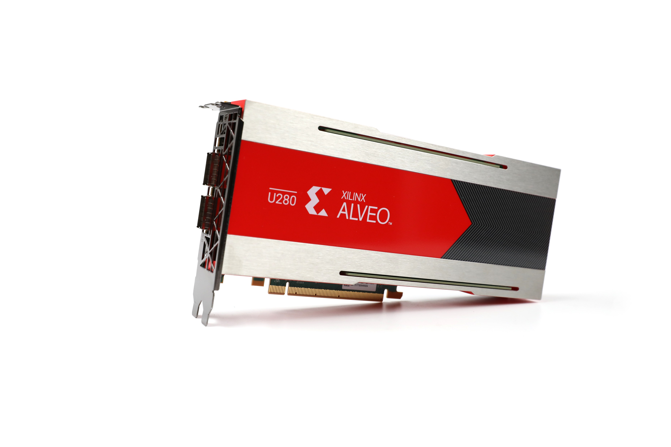
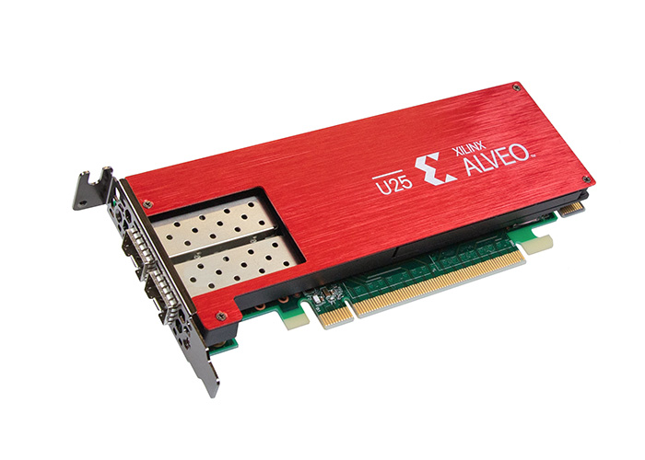
HLS load/compute/store coding style
Coding style for implementing kernels
A (compute) kernel is a function or subroutine compiled for high throughput hardware devices called accelerators
Accelerators can be graphics processing units (GPUs), digital signal processors (DSPs), or field-programmable gate arrays (FPGAs)
Accelerators do not include traditional CPUs (central processing units)
Xilinx Alveo FPGA Accelerators
Alveo U25 SmartNIC Accelerator Card
Alveo U280 Data Center Accelerator Card

Slide 180
Load/Compute/Store Functions Execute in Parallel on Device Through Pipelining
Dataflow diagram:
load_input
global memory
load_input
in1_stream
compute_add
in2_stream
out_stream
global memory
store_result

Slide 181
Vector Addition Example
Vector Addition example has two component C++ source files: vadd.cpp and host.cpp
vadd.cpp contains code that will be synthesized into a register-transfer level (RTL) digital circuit design and execute on an FPGA (in accelerated hardware) board connected to a computer system’s PCIe bus
host.cpp contains “driver” code that will execute on a computer system’s standard CPUs
Uses OpenCL™ framework (Open Computing Language)

Slide 182
host.cpp: Allocate Host Memory for Vectors
Allocate memory on host for CPU to store a vector of 4x2¹⁰ 32-bit integers
#define DATA_SIZE 4096
std::vector<int, aligned_allocator<int> > source_in1(DATA_SIZE);
std::vector<int, aligned_allocator<int> > source_in2(DATA_SIZE);
std::vector<int, aligned_allocator<int> > source_hw_results(DATA_SIZE);
std::vector<int, aligned_allocator<int> > source_sw_results(DATA_SIZE);

Slide 183
host.cpp: Populate Vectors with Integer Data
The source_sw_results[]array contains CPU computed (host-side) “correct” answer used to verify device computed answer is correct
The source_hw_results[]array will contain the FPGA computed (device-side) answer; here we initialize memory to 0
std::generate(source_in1.begin(), source_in1.end(), std::rand);
std::generate(source_in2.begin(), source_in2.end(), std::rand);
for (int i = 0; i < DATA_SIZE; i++) {
source_sw_results[i] = source_in1[i] + source_in2[i];
source_hw_results[i] = 0;
}

Slide 184
host.cpp: flash (program) device
Push bitstream generated by Vivado to device
Vivado platform linker (vpl) generates bitstream, recall this in transcript:
[23:07:58] Starting bitstream generation.. [23:13:32] Creating bitmap... [23:17:31] Writing bitstream ./level0_i_ulp_my_rm_partial.bit... [23:17:31] Finished 6th of 6 tasks (FPGA bitstream generation). Elapsed time: 00h 09m 32s [23:17:30] Run vpl: Step impl: Completed [23:17:31] Run vpl: FINISHED. Run Status: impl Complete!

Slide 185
host.cpp: flash (program) to device
auto devices = xcl::get_xil_devices();
// read_binary_file() is a utility API which will load the binaryFile
// and will return the pointer to file buffer.
auto fileBuf = xcl::read_binary_file(binaryFile);
cl::Program::Binaries bins{{fileBuf.data(), fileBuf.size()}};
bool valid_device = false;
for (unsigned int i = 0; i < devices.size(); i++) {
auto device = devices[i];
// Creating Context and Command Queue for selected Device
OCL_CHECK(err, context = cl::Context(device, nullptr, nullptr, nullptr, &err));
OCL_CHECK(err, q = cl::CommandQueue(context, device, CL_QUEUE_PROFILING_ENABLE, &err));
std::cout << "Trying to program device[" << i << "]: " << device.getInfo<CL_DEVICE_NAME>() << std::endl;
cl::Program program(context, {device}, bins, nullptr, &err);
if (err != CL_SUCCESS) {
std::cout << "Failed to program device[" << i << "] with xclbin file!\n";
} else {
std::cout << "Device[" << i << "]: program successful!\n";
OCL_CHECK(err, krnl_vector_add = cl::Kernel(program, "vadd", &err));
valid_device = true;
break; // we break because we found a valid device
}
}
xclbin file generated during bitstream generation
Iterate through available devices on system
Download xclbin file to device
Specify kernel to execute

Slide 186
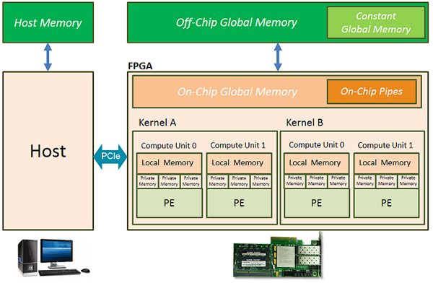
Global Memory
Global Memory is memory that is accessible both by the host’s CPUs and the device (FPGA)
The host must allocate and free buffers in Global Memory
Ref: https://www.xilinx.com/html_docs/xilinx2017_4/sdaccel_doc/bop1504034296858.html
Notes:
Program execution

Slide 187
Host Allocation of Buffers in Global Memory
OCL_CHECK(err, cl::Buffer buffer_in1(context, CL_MEM_USE_HOST_PTR | CL_MEM_READ_ONLY, vector_size_bytes, source_in1.data(), &err));
OCL_CHECK(err, cl::Buffer buffer_in2(context, CL_MEM_USE_HOST_PTR | CL_MEM_READ_ONLY, vector_size_bytes, source_in2.data(), &err));
OCL_CHECK(err, cl::Buffer buffer_output(context, CL_MEM_USE_HOST_PTR | CL_MEM_WRITE_ONLY, vector_size_bytes, source_hw_results.data(), &err));
We specify the CL_MEM_USE_HOST_PTR flag because we want the buffer object in global memory to access the same memory as referenced by the host pointer
Memory efficient configuration
Caveat: data transfer between hosts and devices can be unpredictable: may not be able to safely access the host pointer memory after data communication commences
Notes:
OpenCL (Open Computing Language)

Slide 188
Pass Host Pointers to Device Kernel
Host C++ code: host.cpp
Device C++ kernel code: vadd.cpp
int size = DATA_SIZE;
OCL_CHECK(err, err = krnl_vector_add.setArg(0, buffer_in1));
OCL_CHECK(err, err = krnl_vector_add.setArg(1, buffer_in2));
OCL_CHECK(err, err = krnl_vector_add.setArg(2, buffer_output));
OCL_CHECK(err, err = krnl_vector_add.setArg(3, size));
void vadd(hls::vector<uint32_t, NUM_WORDS>* in1,
hls::vector<uint32_t, NUM_WORDS>* in2,
hls::vector<uint32_t, NUM_WORDS>* out,
int size)

Slide 189
Host Copies Host-side Vector Data to Device Global Memory
cl::CommandQueue q;
.
.
.
OCL_CHECK(err, err = q.enqueueMigrateMemObjects({buffer_in1, buffer_in2}, 0 /* 0 means from host*/));

Slide 190
Host Launches the Synthesized Kernel in FPGA
cl::Kernel krnl_vector_add;
cl::CommandQueue q;
OCL_CHECK(err, krnl_vector_add = cl::Kernel(program, "vadd", &err));
.
.
.
OCL_CHECK(err, err = q.enqueueTask(krnl_vector_add));

Slide 191
Host Copies Result from Device Global Memory to Host Local Memory
OCL_CHECK(err, cl::Buffer buffer_output(context, CL_MEM_USE_HOST_PTR | CL_MEM_WRITE_ONLY, vector_size_bytes, source_hw_results.data(), &err));
.
.
.
OCL_CHECK(err, err = q.enqueueMigrateMemObjects({buffer_output}, CL_MIGRATE_MEM_OBJECT_HOST));
q.finish();

Slide 192
Validate Device (FPGA) Computed Result
In the example code, the device computed result is validated against a “known to be correct” software (i.e.; CPU) computed result.
bool match = true;
for (int i = 0; i < DATA_SIZE; i++) {
if (source_hw_results[i] != source_sw_results[i]) {
std::cout << "Error: Result mismatch" << std::endl;
std::cout << "i = " << i << " CPU result = " << source_sw_results[i]
<< " Device result = " << source_hw_results[i] << std::endl;
match = false;
break;
}
}

Slide 193
Device Allocates Input and Output Streams
load_input
global memory
load_input
static hls::stream<hls::vector<uint32_t, NUM_WORDS> > in1_stream("input_stream_1");
static hls::stream<hls::vector<uint32_t, NUM_WORDS> > in2_stream("input_stream_2");
static hls::stream<hls::vector<uint32_t, NUM_WORDS> > out_stream("output_stream");
in1_stream
compute_add
in2_stream
out_stream
global memory
store_result

Slide 194
Device Loads Input Data into Input Streams
load_input(in1, in1_stream, vSize);
load_input(in2, in2_stream, vSize);
load_input
global memory
load_input
in1_stream
compute_add
in2_stream
out_stream
global memory
store_result

Slide 195
Device Loads Input Data into Input Streams
Global Memory Buffer buffer_in1
static void load_input(hls::vector<uint32_t, NUM_WORDS>* in, hls::stream<hls::vector<uint32_t, NUM_WORDS> >& inStream, int vSize) {
mem_rd:
for (int i = 0; i < vSize; i++) {
#pragma HLS LOOP_TRIPCOUNT min = c_size max = c_size
inStream << in[i];
}
}
vSize = 4096/16 = 256
Notes:
In cases where the loop latency is unknown or cannot be calculate, the TRIPCOUNT pragma lets you specify minimum and maximum iterations for a loop. This lets the tool analyze how the loop latency contributes to the total design latency in the reports, and helps you determine appropriate optimizations for the design.

Slide 196
Device Invokes Computational Function
compute_add(in1_stream, in2_stream, out_stream, vSize);
.
.
.
static void compute_add(hls::stream<hls::vector<uint32_t, NUM_WORDS> >& in1_stream,
hls::stream<hls::vector<uint32_t, NUM_WORDS> >& in2_stream,
hls::stream<hls::vector<uint32_t, NUM_WORDS> >& out_stream,
int vSize) {
// The kernel is operating with vector of NUM_WORDS integers. The + operator performs
// an element-wise add, resulting in NUM_WORDS parallel additions.
execute:
for (int i = 0; i < vSize; i++) {
#pragma HLS LOOP_TRIPCOUNT min = c_size max = c_size
out_stream << (in1_stream.read() + in2_stream.read());
}
}
vSize = 4096/16 = 256

Slide 197
Device Computational Function Execute in Parallel
NUM_WORDS vector elements are added in parallel (simultaneously)
#define MEMORY_DWIDTH 512
#define SIZEOF_WORD 4
#define NUM_WORDS ((MEMORY_DWIDTH) / (8 * SIZEOF_WORD))
NUM_WORDS == 16
Note integer division: int vSize = size / NUM_WORDS; // vSize = 4096/16 = 256

Slide 198
Device Stores Result in Output Stream
static void store_result(hls::vector<uint32_t, NUM_WORDS>* out, hls::stream<hls::vector<uint32_t, NUM_WORDS> >& out_stream,int vSize)
{
mem_wr:
for (int i = 0; i < vSize; i++) {
#pragma HLS LOOP_TRIPCOUNT min = c_size max = c_size
out[i] = out_stream.read();
}
}
Global Memory Buffer buffer_output

Slide 199
xbutil validate
root@aptd:/home/nautilus/Vitis_Accel_Examples/hello_world# /opt/xilinx/xrt/bin/xbutil validate --device 0000:81:00.1
Starting validation for 1 devices
Validate Device : [0000:81:00.1]
Platform : xilinx_u280_xdma_201920_3
SC Version : 4.3.15
Platform ID : 0x5e278820
-------------------------------------------------------------------------------
Test 1 [0000:81:00.1] : Aux connection
Test Status : [PASSED]
-------------------------------------------------------------------------------
Test 2 [0000:81:00.1] : PCIE link
Test Status : [PASSED]
-------------------------------------------------------------------------------
Test 3 [0000:81:00.1] : SC version
Test Status : [PASSED]
-------------------------------------------------------------------------------
Test 4 [0000:81:00.1] : Verify kernel
Test Status : [PASSED]
-------------------------------------------------------------------------------
Test 5 [0000:81:00.1] : DMA
Details : Host -> PCIe -> FPGA write bandwidth = 10264.2 MB/s
Host <- PCIe <- FPGA read bandwidth = 4539.1 MB/s
Test Status : [PASSED]
-------------------------------------------------------------------------------
Test 6 [0000:81:00.1] : iops
Details : IOPS: 84858 (hello)
Test Status : [PASSED]
-------------------------------------------------------------------------------
Test 7 [0000:81:00.1] : Bandwidth kernel
Details : Maximum throughput: 43825 MB/s
Test Status : [PASSED]
-------------------------------------------------------------------------------
Test 8 [0000:81:00.1] : vcu
Validation completed. Please run the command '--verbose' option for more details
Validation Summary
------------------
1 device evaluated
1 device validated successfully
0 device had exceptions during validation
Validated successfully [1 device]
- [0000:81:00.1] : xilinx_u280_xdma_201920_3
Validation Exceptions [0 device]
Warnings produced during test [0 device] (Note: The given test successfully validated)

Slide 200
xbmgmt flash --scan --verbose
root@aptd:/home/nautilus# /opt/xilinx/xrt/bin/xbmgmt flash --scan --verbose
Card [0000:81:00.0]
Card type: u280
Flash type: SPI
Flashable partition running on FPGA:
xilinx_u280_xdma_201920_3,[ID=0x5e278820],[SC=4.3.15]
Flashable partitions installed in system:
xilinx_u280_xdma_201920_3,[ID=0x5e278820],[SC=4.3.15]
Card name ALVEO U280 PQ
Card S/N: 21770205K02M
Config mode: 7
Fan presence: P
Max power level: 225W
MAC address0: 00:0A:35:06:9F:14
MAC address1: 00:0A:35:06:9F:15
MAC address2: Unassigned
MAC address3: Unassigned

Slide 201
Vector Addition on Xilinx Alveo
In this lab exercise we will modify a simple vector addition example code to add three sequences of numbers. The original vector addition example adds two sequences of random numbers and returns a sequence of element-by-element pair-wise sums. The actual vector addition is performed in hardware (in a field-programmable gate array or FPGA). To prepare for this assignment, first complete steps so you can learn how to compile, validate, and synthesize the vector addition kernel into logic that is programmed onto a Xilinx Alveo U280 FPGA.
At the shell prompt, type command
git clone https://github.com/Xilinx/Vitis_Accel_Examples.git
paolini@aptd:~$ git clone https://github.com/Xilinx/Vitis_Accel_Examples.git Cloning into 'Vitis_Accel_Examples'... remote: Enumerating objects: 41729, done. remote: Counting objects: 100% (14702/14702), done. remote: Compressing objects: 100% (4392/4392), done. remote: Total 41729 (delta 12017), reused 12660 (delta 10136), pack-reused 27027 Receiving objects: 100% (41729/41729), 40.86 MiB | 5.87 MiB/s, done. Resolving deltas: 100% (34022/34022), done.
to download the example codes.

Slide 202
Vector Addition on Xilinx Alveo
Then change your working directory to ~/Vitis_Accel_Examples/hello_world using command
cd ~/Vitis_Accel_Examples/hello_world
Type make clean to start from scratch:
paolini@aptd:~/Vitis_Accel_Examples/hello_world$ make clean rm -rf ./hello_world /{*sw_emu*,*hw_emu*} rm -rf profile_* TempConfig system_estimate.xtxt *.rpt *.csv rm -rf src/*.ll *v++* .Xil emconfig.json dltmp* xmltmp* *.log *.jou *.wcfg *.wdb
Type
faketime '2021-12-31 12:00:00' make all TARGET=sw_emu PLATFORM=xilinx_u280_xdma_201920_3
to build the vector addition example in software emulation mode:
paolini@aptd:~/Vitis_Accel_Examples/hello_world$ make all TARGET=sw_emu PLATFORM= xilinx_u280_xdma_201920_3 g++ -o hello_world /home/paolini/Vitis_Accel_Examples/common/includes/xcl2/xcl2.cpp src/host.cpp -I/opt/xilinx/xrt/include -I/tools/Xilinx/Vivado/2021.1/include -Wall -O0 -g -std=c++1y -I/home/paolini/Vitis_Accel_Examples/common/includes/xcl2 -fmessage-length=0 -L/opt/xilinx/xrt/lib -lOpenCL -pthread -lrt -lstdc++ mkdir -p ./_x.sw_emu.xilinx_u25_gen3x8_xdma_1_202010_1 v++ -t sw_emu --platform xilinx_u25_gen3x8_xdma_1_202010_1 --save-temps -g -c -k vadd --temp_dir ./_x.sw_emu.xilinx_u25_gen3x8_xdma_1_202010_1 -I'src' -o'_x.sw_emu.xilinx_u25_gen3x8_xdma_1_202010_1/vadd.xo' 'src/vadd.cpp' Option Map File Used: '/tools/Xilinx/Vitis/2021.1/data/vitis/vpp/optMap.xml'
****** v++ v2021.1 (64-bit) **** SW Build 3246112 on 2021-06-09-14:19:56 ** Copyright 1986-2020 Xilinx, Inc. All Rights Reserved
.
.
.
INFO: [ConfigUtil 60-1032]
emulation configuration file `emconfig.json` is created in ./_x.sw_emu.xilinx_u280_xdma_201920_3 directory

Slide 203
Vector Addition on Xilinx Alveo
Type
paolini@aptd:~/Vitis_Accel_Examples/hello_world$ faketime '2021-12-31 12:00:00' make all TARGET=hw PLATFORM=xilinx_u280_xdma_201920_3
to build the vector addition example vadd.xclbin file for hardware mode (on the device FPGA). The build process will take a long time to complete (eta. total elapsed time: 1h 18m 54s).
mkdir -p ./_x.hw.xilinx_u280_xdma_201920_3
v++ -t hw --platform xilinx_u280_xdma_201920_3 --save-temps -c -k vadd --temp_dir . /_x.hw.xilinx_u280_xdma_201920_3 -I'src' -o'_x.hw.xilinx_u280_xdma_201920_3/vadd.xo ' 'src/vadd.cpp'
Option Map File Used: '/tools/Xilinx/Vitis/2021.1/data/vitis/vpp/optMap.xml'
****** v++ v2021.1 (64-bit)
**** SW Build 3246112 on 2021-06-09-14:19:56
** Copyright 1986-2020 Xilinx, Inc. All Rights Reserved.
.
.
.
INFO: [v++ 60-2460] Successfully copied a temporary xclbin to the output xclbin: /home/paolini/Vitis_Accel_Examples/hello_world/./build_dir.hw.xilinx_u280_xdma_201920_3/vadd.xclbin

Slide 204
Vector Addition on Xilinx Alveo
Type
paolini@aptd:~/Vitis_Accel_Examples/hello_world$ faketime '2021-12-31 12:00:00' make run TARGET=hw PLATFORM=xilinx_u280_xdma_201920_3
to run the vector addition example in hardware mode. You should see the message TEST PASSED. The vector addition is performed by the device FPGA in this mode.
./hello_world ./build_dir.hw.xilinx_u280_xdma_201920_3/vadd.xclbin
Found Platform
Platform Name: Xilinx
INFO: Reading ./build_dir.hw.xilinx_u280_xdma_201920_3/vadd.xclbin
Loading: './build_dir.hw.xilinx_u280_xdma_201920_3/vadd.xclbin'
Trying to program device[0]: xilinx_u280_xdma_201920_3
Device[0]: program successful!
TEST PASSED

